Slide 1
Unit II – Relational databases
Relational Model: Structure of Relational Databases, Database Schema, Keys, Relational Query languages, Relational Algebra, Tuple Relational Calculus and Domain Relational calculus. Relational Operations.
SQL: SQL data definition, Basic Structure of SQL Queries, Additional Basic operations, Set Operations, Null Values, Aggregate Functions, Nested Queries, Modification of databases, Join Expressions, views, Transactions, Integrity Constraints, SQL datatypes and schemas, Authorization, Functions and procedures, Triggers, Recursive Queries

Slide 2
Chapter 2 Intro to Relational Model

Slide 3
Structure of Relational Databases

Slide 4
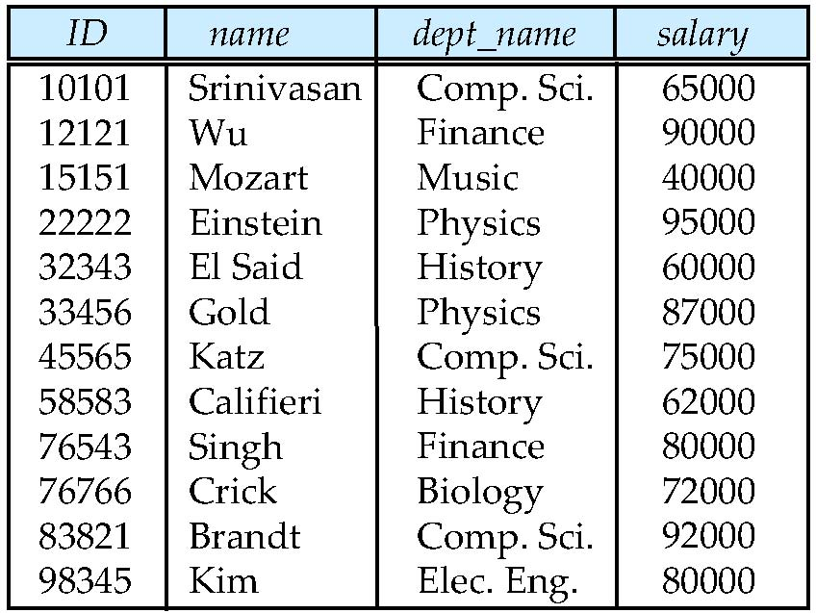
Example of a Relation
attributes
(or columns)
tuples
(or rows)

Slide 5
Attribute Types
The set of allowed values for each attribute is called the domain of the attribute
Attribute values are (normally) required to be atomic; that is, indivisible
The special value null is a member of every domain. Indicated that the value is “unknown”
The null value causes complications in the definition of many operations

Slide 6
Database Schema

Slide 7
Relation Schema and Instance
A₁, A₂, …, A_{n} are attributes
R = (A₁, A₂, …, A_{n} ) is a relation schema
Example:
instructor = (ID, name, dept_name, salary)
Formally, given sets D₁, D₂, …. D_{n} a relation r is a subset of D₁ x D₂ x … x D_{n} Thus, a relation is a set of n-tuples (a₁, a₂, …, a_{n}) where each a_{i} ∈ D_{i}
The current values (relation instance) of a relation are specified by a table
An element t of r is a tuple, represented by a row in a table

Slide 8
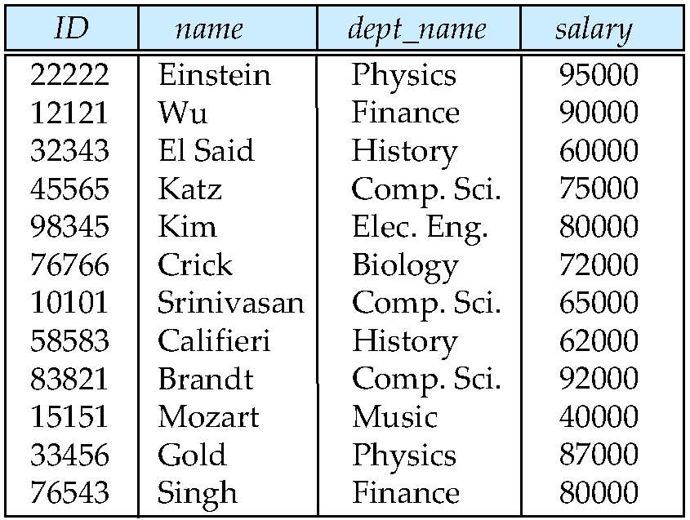
Relations are Unordered
Order of tuples is irrelevant (tuples may be stored in an arbitrary order)
Example: instructor relation with unordered tuples

Slide 9
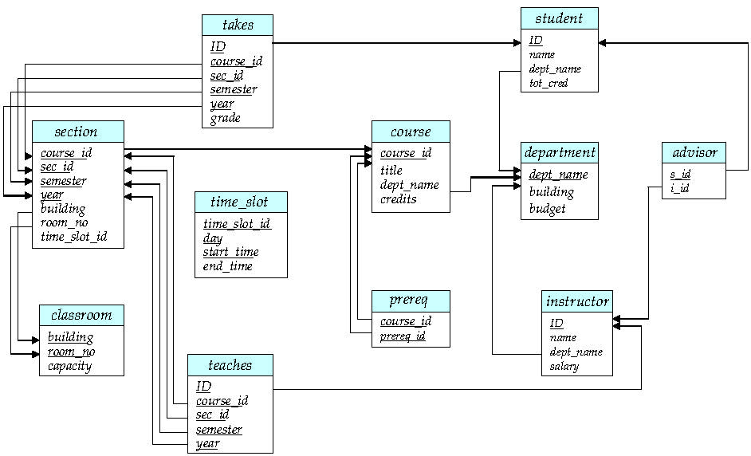
Schema Diagram for University Database

Slide 10
Keys

Slide 11
Keys
Let K ⊆ R
K is a superkey of R if values for K are sufficient to identify a unique tuple of each possible relation r(R)
Example: {ID} and {ID,name} are both superkeys of instructor.
Superkey K is a candidate key if K is minimal Example: {ID} is a candidate key for Instructor
One of the candidate keys is selected to be the primary key.
which one?
Foreign key constraint: Value in one relation must appear in another
Referencing relation
Referenced relation
Example – dept_name in instructor is a foreign key from instructor referencing department

Slide 12
Relational Query Languages

Slide 13
Relational Query Languages
Procedural vs .non-procedural, or declarative
“Pure” languages:
Relational algebra
Tuple relational calculus
Domain relational calculus
The above 3 pure languages are equivalent in computing power
We will concentrate in this chapter on relational algebra
Not turning-machine equivalent
consists of 6 basic operations

Slide 14
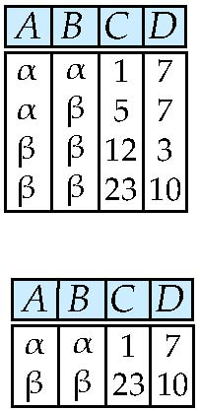
Select Operation – selection of rows (tuples)
Relation r
σ_{A=B ^ D > 5} (r)

Slide 15
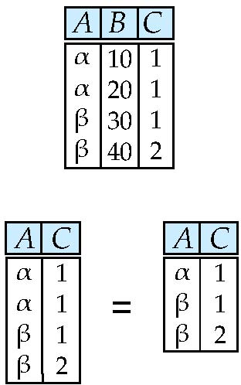
Project Operation – selection of columns (Attributes)
Relation r:
∏_{A,C} (r)

Slide 16
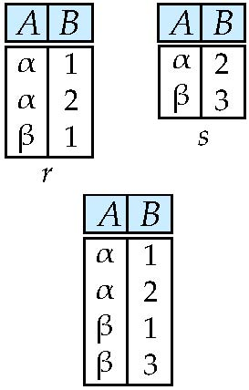
Union of two relations
Relations r, s:
r ∪ s:

Slide 17
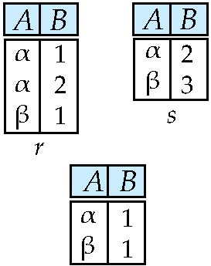
Set difference of two relations
Relations r, s:
r – s:

Slide 18
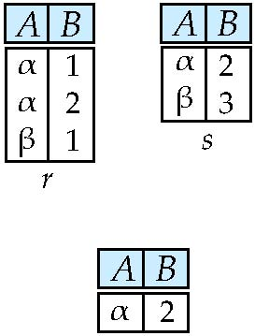
Set intersection of two relations
Relation r, s:
r ∩ s
Note: r ∩ s = r – (r – s)

Slide 19
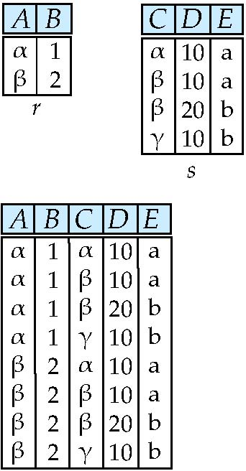
joining two relations -- Cartesian-product
Relations r, s:
r x s:

Slide 20
Cartesian-product – naming issue
B
Relations r, s:
r.B
s.B
r x s:

Slide 21
Renaming a Table
Allows us to refer to a relation, (say E) by more than one name.
ρ _{x} (E)
returns the expression E under the name X
Relations r
r x ρ _{s} (r)
r.A r.B s.A s.B
α
α
β
β
1
1
2
2
α
β
α
β
1
2
1
2

Slide 22
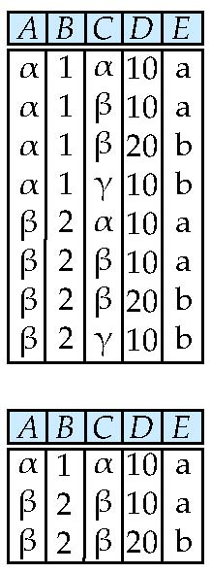
Composition of Operations
Can build expressions using multiple operations
Example: σ_{A=C} (r x s)
r x s
σ_{A=C} (r x s)

Slide 23
Joining two relations – Natural Join
Let r and s be relations on schemas R and S respectively. Then, the “natural join” of relations R and S is a relation on schema R ∪ S obtained as follows:
Consider each pair of tuples t_{r} from r and t_{s} from s.
If t_{r} and t_{s} have the same value on each of the attributes in R ∩ S, add a tuple t to the result, where
t has the same value as t_{r} on r
t has the same value as t_{s} on s

Slide 24
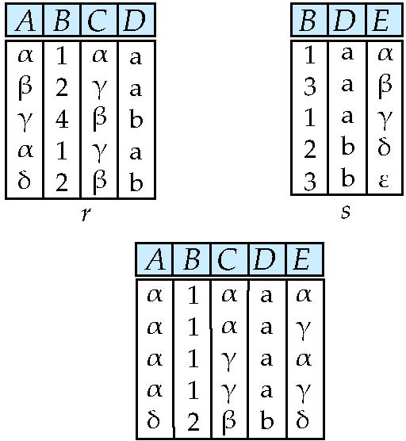
Natural Join Example
Relations r, s:
Natural Join
r s
∏ _{A, r.B, C, r.D, E} (σ _{r.B = s.B ˄ r.D = s.D} (r x s)))

Slide 25
Notes about Relational Languages
Each Query input is a table (or set of tables)
Each query output is a table.
All data in the output table appears in one of the input tables
Relational Algebra is not Turning complete
Can we compute:
SUM
AVG
MAX
MIN
Notes:
25

Slide 26
Summary of Relational Algebra Operators
Symbol (Name) Example of Use
σ
(Selection) ^{σ} salary > = 85000 ^{(instructor)}
Return rows of the input relation that satisfy the predicate.
Π
(Projection) ^{Π} ID, salary ^{(instructor)}
Output specified attributes from all rows of the input relation. Remove duplicate tuples from the output.
x
(Cartesian Product) instructor x department
Output pairs of rows from the two input relations that have the same value on all attributes that have the same name.
∪
(Union) ^{Π} name ^{(instructor) ∪ Π} name ^{(student)}
Output the union of tuples from the two input relations.
-
(Set Difference) ^{Π} name ^{(instructor)} ^{-- Π} name ^{(student)}
Output the set difference of tuples from the two input relations.
⋈
(Natural Join) instructor ⋈ department
Output pairs of rows from the two input relations that have the same value on all attributes that have the same name.

Slide 27
End of Chapter 2

Slide 28
Chapter 6: Formal Relational Query Languages

Slide 29
Outline
Relational Algebra
Tuple Relational Calculus
Domain Relational Calculus

Slide 30
Relational Algebra

Slide 31
Relational Algebra
Procedural language
Six basic operators
select: σ
project: ∏
union: ∪
set difference: –
Cartesian product: x
rename: ρ
The operators take one or two relations as inputs and produce a new relation as a result.

Slide 32
Select Operation
Notation: σ _{p}(r)
p is called the selection predicate
Defined as: σ_{p}(r) = {t | t ∈ r and p(t)}
Where p is a formula in propositional calculus consisting of terms connected by : ∧ (and), ∨ (or), ¬ (not) Each term is one of:
<attribute> op <attribute> or <constant>
where op is one of: =, ≠, >, ≥. <. ≤
Example of selection: σ _{dept_name=“Physics”}(instructor)

Slide 33
Project Operation
Notation:
where A₁, A₂ are attribute names and r is a relation name.
The result is defined as the relation of k columns obtained by erasing the columns that are not listed
Duplicate rows removed from result, since relations are sets
Example: To eliminate the dept_name attribute of instructor ∏_{ID, name, salary} (instructor)

Slide 34
Union Operation
Notation: r ∪ s
Defined as:
r ∪ s = {t | t ∈ r or t ∈ s}
For r ∪ s to be valid.
1. r, s must have the same arity (same number of attributes)
2. The attribute domains must be compatible (example: 2nd column of r deals with the same type of values as does the 2nd column of s)
Example: to find all courses taught in the Fall 2009 semester, or in the Spring 2010 semester, or in both ∏_{course_id} (σ _{semester=“Fall” Λ year=2009} (section)) ∪ ∏_{course_id} (σ _{semester=“Spring” Λ year=2010} (section))

Slide 35
Set Difference Operation
Notation r – s
Defined as:
r – s = {t | t ∈ r and t ∉ s}
Set differences must be taken between compatible relations.
r and s must have the same arity
attribute domains of r and s must be compatible
Example: to find all courses taught in the Fall 2009 semester, but not in the Spring 2010 semester ∏_{course_id} (σ _{semester=“Fall” Λ year=2009} (section)) − ∏_{course_id} (σ _{semester=“Spring” Λ year=2010} (section))

Slide 36
Set-Intersection Operation
Notation: r ∩ s
Defined as:
r ∩ s = { t | t ∈ r and t ∈ s }
Assume:
r, s have the same arity
attributes of r and s are compatible
Note: r ∩ s = r – (r – s)

Slide 37
Cartesian-Product Operation
Notation r x s
Defined as:
r x s = {t q | t ∈ r and q ∈ s}
Assume that attributes of r(R) and s(S) are disjoint. (That is, R ∩ S = ∅).
If attributes of r(R) and s(S) are not disjoint, then renaming must be used.

Slide 38
Rename Operation
Allows us to name, and therefore to refer to, the results of relational-algebra expressions.
Allows us to refer to a relation by more than one name.
Example:
ρ _{x} (E)
returns the expression E under the name X
If a relational-algebra expression E has arity n, then
returns the result of expression E under the name X, and with the
attributes renamed to A₁ , A₂ , …., A_{n} .

Slide 39
Formal Definition
A basic expression in the relational algebra consists of either one of the following:
A relation in the database
A constant relation
Let E₁ and E₂ be relational-algebra expressions; the following are all relational-algebra expressions:
E₁ ∪ E₂
E₁ – E₂
E₁ x E₂
σ_{p} (E₁), P is a predicate on attributes in E₁
∏_{s}(E₁), S is a list consisting of some of the attributes in E₁
ρ _{x} (E₁), x is the new name for the result of E₁

Slide 40
Tuple Relational Calculus

Slide 41
Tuple Relational Calculus
A nonprocedural query language, where each query is of the form
{t | P (t ) }
It is the set of all tuples t such that predicate P is true for t
t is a tuple variable, t [A ] denotes the value of tuple t on attribute A
t ∈ r denotes that tuple t is in relation r
P is a formula similar to that of the predicate calculus

Slide 42
Predicate Calculus Formula
1. Set of attributes and constants
2. Set of comparison operators: (e.g., <, ≤, =, ≠, >, ≥)
3. Set of connectives: and (∧), or (v)‚ not (¬)
4. Implication (⇒): x ⇒ y, if x if true, then y is true
x ⇒ y ≡ ¬x v y
5. Set of quantifiers:
∃ t ∈ r (Q (t )) ≡ ”there exists” a tuple in t in relation r such that predicate Q (t ) is true
∀t ∈ r (Q (t )) ≡ Q is true “for all” tuples t in relation r

Slide 43
Example Queries
Find the ID, name, dept_name, salary for instructors whose salary is greater than $80,000
{t | t ∈ instructor ∧ t [salary ] > 80000}
Notice that a relation on schema (ID, name, dept_name, salary) is implicitly defined by the query
As in the previous query, but output only the ID attribute value
{t | ∃ s ∈ instructor (t [ID ] = s [ID ] ∧ s [salary ] > 80000)}
Notice that a relation on schema (ID) is implicitly defined by the query

Slide 44
Example Queries
Find the names of all instructors whose department is in the Watson building
{t | ∃s ∈ instructor (t [name ] = s [name ] ∧ ∃u ∈ department (u [dept_name ] = s[dept_name] “ ∧ u [building] = “Watson” ))}
Find the set of all courses taught in the Fall 2009 semester, or in the Spring 2010 semester, or both
{t | ∃s ∈ section (t [course_id ] = s [course_id ] ∧ s [semester] = “Fall” ∧ s [year] = 2009 v ∃u ∈ section (t [course_id ] = u [course_id ] ∧ u [semester] = “Spring” ∧ u [year] = 2010 )}

Slide 45
Example Queries
Find the set of all courses taught in the Fall 2009 semester, and in the Spring 2010 semester
{t | ∃s ∈ section (t [course_id ] = s [course_id ] ∧ s [semester] = “Fall” ∧ s [year] = 2009 ∧ ∃u ∈ section (t [course_id ] = u [course_id ] ∧ u [semester] = “Spring” ∧ u [year] = 2010 )}
Find the set of all courses taught in the Fall 2009 semester, but not in the Spring 2010 semester
{t | ∃s ∈ section (t [course_id ] = s [course_id ] ∧ s [semester] = “Fall” ∧ s [year] = 2009 ∧ ¬ ∃u ∈ section (t [course_id ] = u [course_id ] ∧ u [semester] = “Spring” ∧ u [year] = 2010 )}

Slide 46
Universal Quantification
Find all students who have taken all courses offered in the Biology department
{t | ∃ r ∈ student (t [ID] = r [ID]) ∧ (∀ u ∈ course (u [dept_name]=“Biology” ⇒ ∃ s ∈ takes (t [ID] = s [ID ] ∧ s [course_id] = u [course_id]))}

Slide 47
Safety of Expressions
It is possible to write tuple calculus expressions that generate infinite relations.
For example, { t | ¬ t ∈ r } results in an infinite relation if the domain of any attribute of relation r is infinite
To guard against the problem, we restrict the set of allowable expressions to safe expressions.
An expression {t | P (t )} in the tuple relational calculus is safe if every component of t appears in one of the relations, tuples, or constants that appear in P
NOTE: this is more than just a syntax condition.
E.g. { t | t [A] = 5 ∨ true } is not safe --- it defines an infinite set with attribute values that do not appear in any relation or tuples or constants in P.

Slide 48
Safety of Expressions (Cont.)
Consider again that query to find all students who have taken all courses offered in the Biology department
{t | ∃ r ∈ student (t [ID] = r [ID]) ∧ (∀ u ∈ course (u [dept_name]=“Biology” ⇒ ∃ s ∈ takes (t [ID] = s [ID ] ∧ s [course_id] = u [course_id]))}
Without the existential quantification on student, the above query would be unsafe if the Biology department has not offered any courses.

Slide 49
Domain Relational Calculus

Slide 50
Domain Relational Calculus
A nonprocedural query language equivalent in power to the tuple relational calculus
Each query is an expression of the form:
{ < x₁, x₂, …, x_{n} > | P (x₁, x₂, …, x_{n})}
x₁, x₂, …, x_{n} represent domain variables
P represents a formula similar to that of the predicate calculus

Slide 51
Example Queries
Find the ID, name, dept_name, salary for instructors whose salary is greater than $80,000
{< i, n, d, s> | < i, n, d, s> ∈ instructor ∧ s > 80000}
As in the previous query, but output only the ID attribute value
{< i> | < i, n, d, s> ∈ instructor ∧ s > 80000}
Find the names of all instructors whose department is in the Watson building
{< n > | ∃ i, d, s (< i, n, d, s > ∈ instructor ∧ ∃ b, a (< d, b, a> ∈ department ∧ b = “Watson” ))}

Slide 52
Example Queries
Find the set of all courses taught in the Fall 2009 semester, or in the Spring 2010 semester, or both
{<c> | ∃ a, s, y, b, r, t ( <c, a, s, y, b, r, t > ∈ section ∧ s = “Fall” ∧ y = 2009 ) v ∃ a, s, y, b, r, t ( <c, a, s, y, b, r, t > ∈ section ] ∧ s = “Spring” ∧ y = 2010)}
This case can also be written as {<c> | ∃ a, s, y, b, r, t ( <c, a, s, y, b, r, t > ∈ section ∧ ( (s = “Fall” ∧ y = 2009 ) v (s = “Spring” ∧ y = 2010))}
Find the set of all courses taught in the Fall 2009 semester, and in the Spring 2010 semester
{<c> | ∃ a, s, y, b, r, t ( <c, a, s, y, b, r, t > ∈ section ∧ s = “Fall” ∧ y = 2009 ) ∧ ∃ a, s, y, b, r, t ( <c, a, s, y, b, r, t > ∈ section ] ∧ s = “Spring” ∧ y = 2010)}

Slide 53
Safety of Expressions
The expression:
{ < x₁, x₂, …, x_{n} > | P (x₁, x₂, …, x_{n} )}
is safe if all of the following hold:
All values that appear in tuples of the expression are values from dom (P ) (that is, the values appear either in P or in a tuple of a relation mentioned in P ).
For every “there exists” subformula of the form ∃ x (P₁(x )), the subformula is true if and only if there is a value of x in dom (P₁) such that P₁(x ) is true.
For every “for all” subformula of the form ∀_{x} (P₁ (x )), the subformula is true if and only if P₁(x ) is true for all values x from dom (P₁).

Slide 54
Universal Quantification
Find all students who have taken all courses offered in the Biology department
{< i > | ∃ n, d, tc ( < i, n, d, tc > ∈ student ∧ (∀ ci, ti, dn, cr ( < ci, ti, dn, cr > ∈ course ∧ dn =“Biology” ⇒ ∃ si, se, y, g ( <i, ci, si, se, y, g> ∈ takes ))}
Note that without the existential quantification on student, the above query would be unsafe if the Biology department has not offered any courses.

Slide 55
Chapter 3: Introduction to SQL

Slide 56
Chapter 3: Introduction to SQL

Slide 57
Outline
Overview of The SQL Query Language
Data Definition
Basic Query Structure
Additional Basic Operations
Set Operations
Null Values
Aggregate Functions
Nested Subqueries
Modification of the Database
Notes:
1

Slide 58
History
IBM Sequel language developed as part of System R project at the IBM San Jose Research Laboratory
Renamed Structured Query Language (SQL)
ANSI and ISO standard SQL:
SQL-86
SQL-89
SQL-92
SQL:1999 (language name became Y2K compliant!)
SQL:2003
Commercial systems offer most, if not all, SQL-92 features, plus varying feature sets from later standards and special proprietary features.
Not all examples here may work on your particular system.

Slide 59
Data Definition Language
The SQL data-definition language (DDL) allows the specification of information about relations, including:
The schema for each relation.
The domain of values associated with each attribute.
Integrity constraints
And as we will see later, also other information such as
The set of indices to be maintained for each relations.
Security and authorization information for each relation.
The physical storage structure of each relation on disk.

Slide 60
Domain Types in SQL
char(n). Fixed length character string, with user-specified length n.
varchar(n). Variable length character strings, with user-specified maximum length n.
int. Integer (a finite subset of the integers that is machine-dependent).
smallint. Small integer (a machine-dependent subset of the integer domain type).
numeric(p,d). Fixed point number, with user-specified precision of p digits, with d digits to the right of decimal point. (ex., numeric(3,1), allows 44.5 to be stores exactly, but not 444.5 or 0.32)
real, double precision. Floating point and double-precision floating point numbers, with machine-dependent precision.
float(n). Floating point number, with user-specified precision of at least n digits.
More are covered in Chapter 4.

Slide 61
Create Table Construct
An SQL relation is defined using the create table command:
create table r (A₁ D₁, A₂ D₂, ..., A_{n} D_{n}, (integrity-constraint₁), ..., (integrity-constraint_{k}))
r is the name of the relation
each A_{i} is an attribute name in the schema of relation r
D_{i} is the data type of values in the domain of attribute A_{i}
Example:
create table instructor ( ID char(5), name varchar(20), dept_name varchar(20), salary numeric(8,2))

Slide 62
Integrity Constraints in Create Table
not null
primary key (A₁, ..., A_{n} )
foreign key (A_{m}, ..., A_{n} ) references r
Example:
create table instructor ( ID char(5), name varchar(20) not null, dept_name varchar(20), salary numeric(8,2), primary key (ID), foreign key (dept_name) references department);
Note:
primary key declaration on an attribute automatically ensures not null

Slide 63
And a Few More Relation Definitions
create table student ( ID varchar(5), name varchar(20) not null, dept_name varchar(20), tot_cred numeric(3,0), primary key (ID),
foreign key (dept_name) references department);
create table takes ( ID varchar(5), course_id varchar(8), sec_id varchar(8), semester varchar(6), year numeric(4,0), grade varchar(2),
primary key (ID, course_id, sec_id, semester, year) ,
foreign key (ID) references student, foreign key (course_id, sec_id, semester, year) references section);
Note: sec_id can be dropped from primary key above, to ensure a student cannot be registered for two sections of the same course in the same semester

Slide 64
And more still
create table course ( course_id varchar(8), title varchar(50), dept_name varchar(20), credits numeric(2,0),
primary key (course_id),
foreign key (dept_name) references department);

Slide 65
Updates to tables
Insert
insert into instructor values (‘10211’, ’Smith’, ’Biology’, 66000);
Delete
Remove all tuples from the student relation
delete from student
Drop Table
drop table r
Alter
alter table r add A D
where A is the name of the attribute to be added to relation r and D is the domain of A.
All exiting tuples in the relation are assigned null as the value for the new attribute.
alter table r drop A
where A is the name of an attribute of relation r
Dropping of attributes not supported by many databases.

Slide 66
Basic Query Structure
A typical SQL query has the form: select A₁, A₂, ..., A_{n} from r₁, r₂, ..., r_{m} where P
A_{i} represents an attribute
R_{i} represents a relation
P is a predicate.
The result of an SQL query is a relation.
Notes:
2

Slide 67
The select Clause
The select clause lists the attributes desired in the result of a query
corresponds to the projection operation of the relational algebra
Example: find the names of all instructors: select name from instructor
NOTE: SQL names are case insensitive (i.e., you may use upper- or lower-case letters.)
E.g., Name ≡ NAME ≡ name
Some people use upper case wherever we use bold font.
Notes:
3

Slide 68
The select Clause (Cont.)
SQL allows duplicates in relations as well as in query results.
To force the elimination of duplicates, insert the keyword distinct after select.
Find the department names of all instructors, and remove duplicates
select distinct dept_name from instructor
The keyword all specifies that duplicates should not be removed.
select all dept_name from instructor
Notes:
4

Slide 69
The select Clause (Cont.)
An asterisk in the select clause denotes “all attributes”
select * from instructor
An attribute can be a literal with no from clause
select ‘437’
Results is a table with one column and a single row with value “437”
Can give the column a name using:
select ‘437’ as FOO
An attribute can be a literal with from clause
select ‘A’ from instructor
Result is a table with one column and N rows (number of tuples in the instructors table), each row with value “A”
Notes:
5

Slide 70
The select Clause (Cont.)
The select clause can contain arithmetic expressions involving the operation, +, –, ∗, and /, and operating on constants or attributes of tuples.
The query:
select ID, name, salary/12 from instructor
would return a relation that is the same as the instructor relation, except that the value of the attribute salary is divided by 12.
Can rename “salary/12” using the as clause:
select ID, name, salary/12 as monthly_salary
Notes:
5

Slide 71
The where Clause
The where clause specifies conditions that the result must satisfy
Corresponds to the selection predicate of the relational algebra.
To find all instructors in Comp. Sci. dept
select name from instructor where dept_name = ‘Comp. Sci.'
Comparison results can be combined using the logical connectives and, or, and not
To find all instructors in Comp. Sci. dept with salary > 80000
select name from instructor where dept_name = ‘Comp. Sci.' and salary > 80000
Comparisons can be applied to results of arithmetic expressions.
Notes:
6

Slide 72
The from Clause
The from clause lists the relations involved in the query
Corresponds to the Cartesian product operation of the relational algebra.
Find the Cartesian product instructor X teaches
select ∗ from instructor, teaches
generates every possible instructor – teaches pair, with all attributes from both relations.
For common attributes (e.g., ID), the attributes in the resulting table are renamed using the relation name (e.g., instructor.ID)
Cartesian product not very useful directly, but useful combined with where-clause condition (selection operation in relational algebra).
Notes:
8

Slide 73
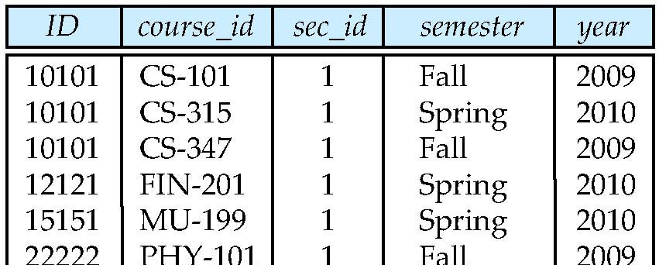
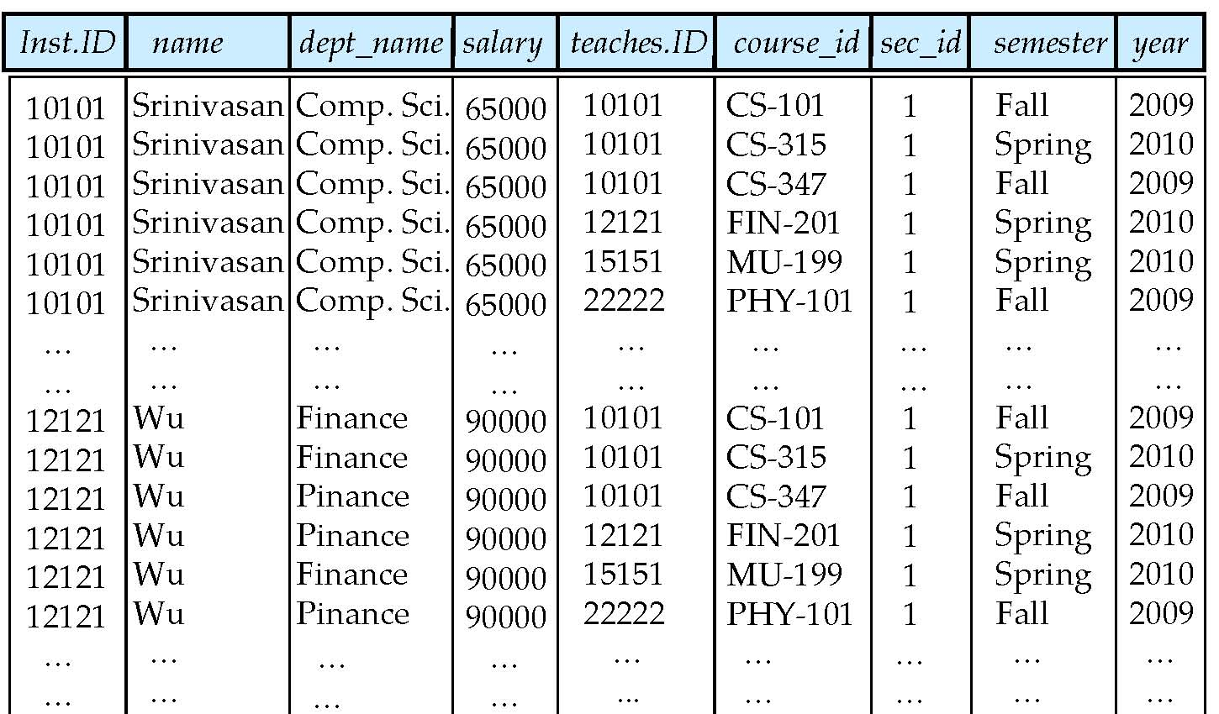
Cartesian Product
instructor
teaches

Slide 74
Examples
Find the names of all instructors who have taught some course and the course_id
select name, course_id from instructor , teaches where instructor.ID = teaches.ID
Find the names of all instructors in the Art department who have taught some course and the course_id
select name, course_id from instructor , teaches where instructor.ID = teaches.ID and instructor. dept_name = ‘Art’
Notes:
9

Slide 75
The Rename Operation
The SQL allows renaming relations and attributes using the as clause:
old-name as new-name
Find the names of all instructors who have a higher salary than some instructor in ‘Comp. Sci’.
select distinct T.name from instructor as T, instructor as S where T.salary > S.salary and S.dept_name = ‘Comp. Sci.’
Keyword as is optional and may be omitted instructor as T ≡ instructor T
Notes:
9

Slide 76
Self Join Example
Relation emp-super
person supervisor
Bob Alice
Mary Susan
Alice David
David Mary
Find the supervisor of “Bob”
Find the supervisor of the supervisor of “Bob”
Find ALL the supervisors (direct and indirect) of “Bob

Slide 77
String Operations
SQL includes a string-matching operator for comparisons on character strings. The operator like uses patterns that are described using two special characters:
percent ( % ). The % character matches any substring.
underscore ( _ ). The _ character matches any character.
Find the names of all instructors whose name includes the substring “dar”.
select name from instructor where name like '%dar%'
Match the string “100%”
like ‘100 \%' escape '\'
in that above we use backslash (\) as the escape character.

Slide 78
String Operations (Cont.)
Patterns are case sensitive.
Pattern matching examples:
‘Intro%’ matches any string beginning with “Intro”.
‘%Comp%’ matches any string containing “Comp” as a substring.
‘_ _ _’ matches any string of exactly three characters.
‘_ _ _ %’ matches any string of at least three characters.
SQL supports a variety of string operations such as
concatenation (using “||”)
converting from upper to lower case (and vice versa)
finding string length, extracting substrings, etc.

Slide 79
Ordering the Display of Tuples
List in alphabetic order the names of all instructors
select distinct name from instructor order by name
We may specify desc for descending order or asc for ascending order, for each attribute; ascending order is the default.
Example: order by name desc
Can sort on multiple attributes
Example: order by dept_name, name

Slide 80
Where Clause Predicates
SQL includes a between comparison operator
Example: Find the names of all instructors with salary between $90,000 and $100,000 (that is, ≥ $90,000 and ≤ $100,000)
select name from instructor where salary between 90000 and 100000
Tuple comparison
select name, course_id from instructor, teaches where (instructor.ID, dept_name) = (teaches.ID, ’Biology’);
Notes:
7

Slide 81
Duplicates
In relations with duplicates, SQL can define how many copies of tuples appear in the result.
Multiset versions of some of the relational algebra operators – given multiset relations r₁ and r₂:
1. σ_{θ} (r₁): If there are c₁ copies of tuple t₁ in r₁, and t₁ satisfies selections σ_{θ,}, then there are c₁ copies of t₁ in σ_{θ} (r₁).
2. Π_{A} (r ): For each copy of tuple t₁ in r₁, there is a copy of tuple Π_{A} (t₁) in Π_{A} (r₁) where Π_{A} (t₁) denotes the projection of the single tuple t₁.
3. r₁ x r₂: If there are c₁ copies of tuple t₁ in r₁ and c₂ copies of tuple t₂ in r₂, there are c₁ x c₂ copies of the tuple t₁. t₂ in r₁ x r₂

Slide 82
Duplicates (Cont.)
Example: Suppose multiset relations r₁ (A, B) and r₂ (C) are as follows:
r₁ = {(1, a) (2,a)} r₂ = {(2), (3), (3)}
Then Π_{B}(r₁) would be {(a), (a)}, while Π_{B}(r₁) x r₂ would be
{(a,2), (a,2), (a,3), (a,3), (a,3), (a,3)}
SQL duplicate semantics:
select A₁,, A₂, ..., A_{n} from r₁, r₂, ..., r_{m} where P
is equivalent to the multiset version of the expression:

Slide 83
Set Operations
Find courses that ran in Fall 2009 or in Spring 2010
(select course_id from section where sem = ‘Fall’ and year = 2009) union (select course_id from section where sem = ‘Spring’ and year = 2010)
Find courses that ran in Fall 2009 and in Spring 2010
(select course_id from section where sem = ‘Fall’ and year = 2009) intersect (select course_id from section where sem = ‘Spring’ and year = 2010)
Find courses that ran in Fall 2009 but not in Spring 2010
(select course_id from section where sem = ‘Fall’ and year = 2009) except (MINUS in Oracle) (select course_id from section where sem = ‘Spring’ and year = 2010)

Slide 84
Set Operations (Cont.)
Find the salaries of all instructors that are less than the largest salary.
select distinct T.salary from instructor as T, instructor as S where T.salary < S.salary
Find all the salaries of all instructors
select distinct salary from instructor
Find the largest salary of all instructors.
(select “second query” ) except (MINUS in Oracle) (select “first query”)
Notes:
9

Slide 85
Set Operations (Cont.)
Set operations union, intersect, and except
Each of the above operations automatically eliminates duplicates
To retain all duplicates use the corresponding multiset versions union all, intersect all and except all.
Suppose a tuple occurs m times in r and n times in s, then, it occurs:
m + n times in r union all s
min(m,n) times in r intersect all s
max(0, m – n) times in r except all s

Slide 86
Null Values
It is possible for tuples to have a null value, denoted by null, for some of their attributes
null signifies an unknown value or that a value does not exist.
The result of any arithmetic expression involving null is null
Example: 5 + null returns null
The predicate is null can be used to check for null values.
Example: Find all instructors whose salary is null.
select name from instructor where salary is null

Slide 87
Null Values and Three Valued Logic
Three values – true, false, unknown
Any comparison with null returns unknown
Example: 5 < null or null <> null or null = null
Three-valued logic using the value unknown:
OR: (unknown or true) = true, (unknown or false) = unknown (unknown or unknown) = unknown
AND: (true and unknown) = unknown, (false and unknown) = false, (unknown and unknown) = unknown
NOT: (not unknown) = unknown
“P is unknown” evaluates to true if predicate P evaluates to unknown
Result of where clause predicate is treated as false if it evaluates to unknown

Slide 88
Aggregate Functions
These functions operate on the multiset of values of a column of a relation, and return a value
avg: average value min: minimum value max: maximum value sum: sum of values count: number of values

Slide 89
Aggregate Functions (Cont.)
Find the average salary of instructors in the Computer Science department
select avg (salary) from instructor where dept_name= ’Comp. Sci.’;
Find the total number of instructors who teach a course in the Spring 2010 semester
select count (distinct ID) from teaches where semester = ’Spring’ and year = 2010;
Find the number of tuples in the course relation
select count (*) from course;

Slide 90
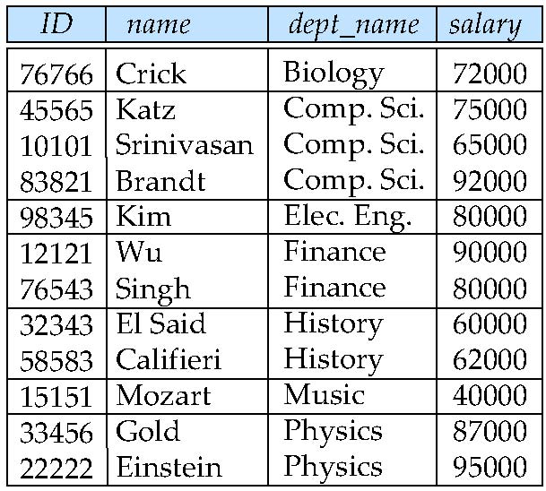
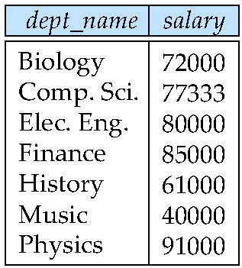
Aggregate Functions – Group By
Find the average salary of instructors in each department
select dept_name, avg (salary) as avg_salary from instructor group by dept_name;
avg_salary

Slide 91
Aggregation (Cont.)
Attributes in select clause outside of aggregate functions must appear in group by list
/* erroneous query */ select dept_name, ID, avg (salary) from instructor group by dept_name;

Slide 92
Aggregate Functions – Having Clause
Find the names and average salaries of all departments whose average salary is greater than 42000
select dept_name, avg (salary)
from instructor
group by dept_name
having avg (salary) > 42000;
Note: predicates in the having clause are applied after the formation of groups whereas predicates in the where clause are applied before forming groups

Slide 93
Null Values and Aggregates
Total all salaries
select sum (salary ) from instructor
Above statement ignores null amounts
Result is null if there is no non-null amount
All aggregate operations except count(*) ignore tuples with null values on the aggregated attributes
What if collection has only null values?
count returns 0
all other aggregates return null

Slide 94
Nested Subqueries
SQL provides a mechanism for the nesting of subqueries. A subquery is a select-from-where expression that is nested within another query.
The nesting can be done in the following SQL query select A₁, A₂, ..., A_{n} from r₁, r₂, ..., r_{m} where P
as follows:
A_{i} can be replaced be a subquery that generates a single value.
r_{i} can be replaced by any valid subquery
P can be replaced with an expression of the form:
B <operation> (subquery)
Where B is an attribute and <operation> to be defined later.

Slide 95
Subqueries in the Where Clause

Slide 96
Subqueries in the Where Clause
A common use of subqueries is to perform tests:
For set membership
For set comparisons
For set cardinality.

Slide 97
Set Membership
Find courses offered in Fall 2009 and in Spring 2010
select distinct course_id
from section
where semester = ’Fall’ and year= 2009 and course_id in (select course_id
from section
where semester = ’Spring’ and year= 2010);
Find courses offered in Fall 2009 but not in Spring 2010
select distinct course_id
from section
where semester = ’Fall’ and year= 2009 and course_id not in (select course_id
from section
where semester = ’Spring’ and year= 2010);

Slide 98
Set Membership (Cont.)
Find the total number of (distinct) students who have taken course sections taught by the instructor with ID 10101
select count (distinct ID)
from takes
where (course_id, sec_id, semester, year) in (select course_id, sec_id, semester, year
from teaches
where teaches.ID= 10101);
Note: Above query can be written in a much simpler manner. The formulation above is simply to illustrate SQL features.

Slide 99
Set Comparison – “some” Clause
Find names of instructors with salary greater than that of some (at least one) instructor in the Biology department.
select distinct T.name
from instructor as T, instructor as S
where T.salary > S.salary and S.dept name = ’Biology’;
Same query using > some clause
select name
from instructor
where salary > some (select salary
from instructor
where dept name = ’Biology’);

Slide 100
Definition of “some” Clause
F <comp> some r ⇔ ∃ t ∈ r such that (F <comp> t ) Where <comp> can be: <, ≤, >, =, ≠
0
(5 < some
5
) = true
(read: 5 < some tuple in the relation)
6
0
(5 < some
5
) = false
0
(5 = some
) = true
5
0
(5 ≠ some
5
) = true (since 0 ≠ 5)
(= some) ≡ in
However, (≠ some) ≡ not in

Slide 101
Set Comparison – “all” Clause
Find the names of all instructors whose salary is greater than the salary of all instructors in the Biology department.
select name
from instructor
where salary > all (select salary
from instructor
where dept name = ’Biology’);

Slide 102
Definition of “all” Clause
F <comp> all r ⇔ ∀ t ∈ r (F <comp> t)
0
(5 < all
5
) = false
6
6
(5 < all
) = true
10
4
(5 = all
) = false
5
4
(5 ≠ all
) = true (since 5 ≠ 4 and 5 ≠ 6)
6
(≠ all) ≡ not in
However, (= all) ≡ in

Slide 103
Test for Empty Relations
The exists construct returns the value true if the argument subquery is nonempty.
exists r ⇔ r ≠ Ø
not exists r ⇔ r = Ø

Slide 104
Use of “exists” Clause
Yet another way of specifying the query “Find all courses taught in both the Fall 2009 semester and in the Spring 2010 semester”
select course_id from section as S where semester = ’Fall’ and year = 2009 and exists (select * from section as T where semester = ’Spring’ and year= 2010 and S.course_id = T.course_id);
Correlation name – variable S in the outer query
Correlated subquery – the inner query

Slide 105
Use of “not exists” Clause
Find all students who have taken all courses offered in the Biology department.
select distinct S.ID, S.name
from student as S
where not exists ( (select course_id
from course
where dept_name = ’Biology’)
except
(select T.course_id
from takes as T
where S.ID = T.ID));
First nested query lists all courses offered in Biology
Second nested query lists all courses a particular student took
Note that X – Y = Ø ⇔ X ⊆ Y
Note: Cannot write this query using = all and its variants

Slide 106
Test for Absence of Duplicate Tuples
The unique construct tests whether a subquery has any duplicate tuples in its result.
The unique construct evaluates to “true” if a given subquery contains no duplicates .
Find all courses that were offered at most once in 2009
select T.course_id from course as T where unique (select R.course_id from section as R where T.course_id= R.course_id and R.year = 2009);

Slide 107
Subqueries in the From Clause

Slide 108
Subqueries in the Form Clause
SQL allows a subquery expression to be used in the from clause
Find the average instructors’ salaries of those departments where the average salary is greater than $42,000.”
select dept_name, avg_salary from (select dept_name, avg (salary) as avg_salary from instructor group by dept_name) where avg_salary > 42000;
Note that we do not need to use the having clause
Another way to write above query
select dept_name, avg_salary from (select dept_name, avg (salary) from instructor group by dept_name) as dept_avg (dept_name, avg_salary)
where avg_salary > 42000;

Slide 109
With Clause
The with clause provides a way of defining a temporary relation whose definition is available only to the query in which the with clause occurs.
Find all departments with the maximum budget with max_budget (value) as (select max(budget) from department) select department.name from department, max_budget where department.budget = max_budget.value;

Slide 110
Complex Queries using With Clause
Find all departments where the total salary is greater than the average of the total salary at all departments
with dept _total (dept_name, value) as
(select dept_name, sum(salary)
from instructor
group by dept_name),
dept_total_avg(value) as
(select avg(value)
from dept_total)
select dept_name
from dept_total, dept_total_avg
where dept_total.value > dept_total_avg.value;

Slide 111
Subqueries in the Select Clause

Slide 112
Scalar Subquery
Scalar subquery is one which is used where a single value is expected
List all departments along with the number of instructors in each department
select dept_name, (select count(*) from instructor where department.dept_name = instructor.dept_name) as num_instructors from department;
Runtime error if subquery returns more than one result tuple

Slide 113
Modification of the Database
Deletion of tuples from a given relation.
Insertion of new tuples into a given relation
Updating of values in some tuples in a given relation

Slide 114
Deletion
Delete all instructors
delete from instructor
Delete all instructors from the Finance department delete from instructor where dept_name= ’Finance’;
Delete all tuples in the instructor relation for those instructors associated with a department located in the Watson building.
delete from instructor where dept name in (select dept name from department where building = ’Watson’);

Slide 115
Deletion (Cont.)
Delete all instructors whose salary is less than the average salary of instructors
delete from instructor
where salary < (select avg (salary)
from instructor);
Problem: as we delete tuples from deposit, the average salary changes
Solution used in SQL:
1. First, compute avg (salary) and find all tuples to delete
2. Next, delete all tuples found above (without
recomputing avg or retesting the tuples)

Slide 116
Insertion
Add a new tuple to course
insert into course values (’CS-437’, ’Database Systems’, ’Comp. Sci.’, 4);
or equivalently
insert into course (course_id, title, dept_name, credits) values (’CS-437’, ’Database Systems’, ’Comp. Sci.’, 4);
Add a new tuple to student with tot_creds set to null
insert into student values (’3003’, ’Green’, ’Finance’, null);

Slide 117
Insertion (Cont.)
Add all instructors to the student relation with tot_creds set to 0
insert into student select ID, name, dept_name, 0 from instructor
The select from where statement is evaluated fully before any of its results are inserted into the relation.
Otherwise queries like
insert into table1 select * from table1
would cause problem

Slide 118
Updates
Increase salaries of instructors whose salary is over $100,000 by 3%, and all others by a 5%
Write two update statements:
update instructor set salary = salary * 1.03 where salary > 100000; update instructor set salary = salary * 1.05 where salary <= 100000;
The order is important
Can be done better using the case statement (next slide)

Slide 119
Case Statement for Conditional Updates
Same query as before but with case statement
update instructor set salary = case when salary <= 100000 then salary * 1.05 else salary * 1.03 end

Slide 120
Updates with Scalar Subqueries
Recompute and update tot_creds value for all students
update student S set tot_cred = (select sum(credits) from takes, course where takes.course_id = course.course_id and S.ID= takes.ID.and takes.grade <> ’F’ and takes.grade is not null);
Sets tot_creds to null for students who have not taken any course
Instead of sum(credits), use:
case when sum(credits) is not null then sum(credits) else 0 end

Slide 121
End of Chapter 3

Slide 122
End of Chapter 3

Slide 123
Chapter 4: Intermediate SQL

Slide 124
Chapter 4: Intermediate SQL
Join Expressions
Views
Transactions
Integrity Constraints
SQL Data Types and Schemas
Authorization
Notes:
1

Slide 125
Joined Relations
Join operations take two relations and return as a result another relation.
A join operation is a Cartesian product which requires that tuples in the two relations match (under some condition). It also specifies the attributes that are present in the result of the join
The join operations are typically used as subquery expressions in the from clause
Three types of joins:
Natural join
Inner join
Outer join

Slide 126
Natural Join in SQL
Natural join matches tuples with the same values for all common attributes, and retains only one copy of each common column.
List the names of instructors along with the course ID of the courses that they taught
select name, course_id from students, takes where student.ID = takes.ID;
Same query in SQL with “natural join” construct
select name, course_id from student natural join takes;

Slide 127
Natural Join in SQL (Cont.)
The from clause can have multiple relations combined using natural join:
select A₁, A₂, … A_{n} from r₁ natural join r₂ natural join .. natural join r_{n} where P ;

Slide 128
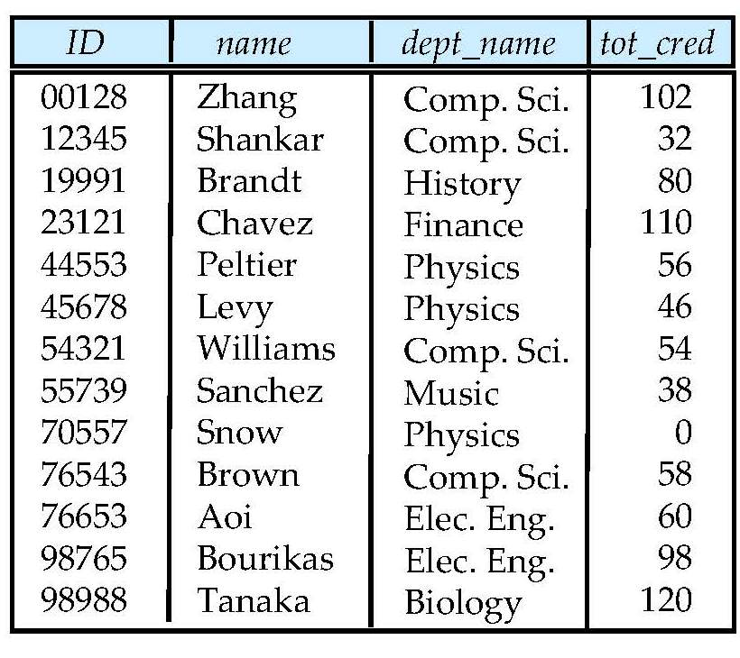
Student Relation

Slide 129
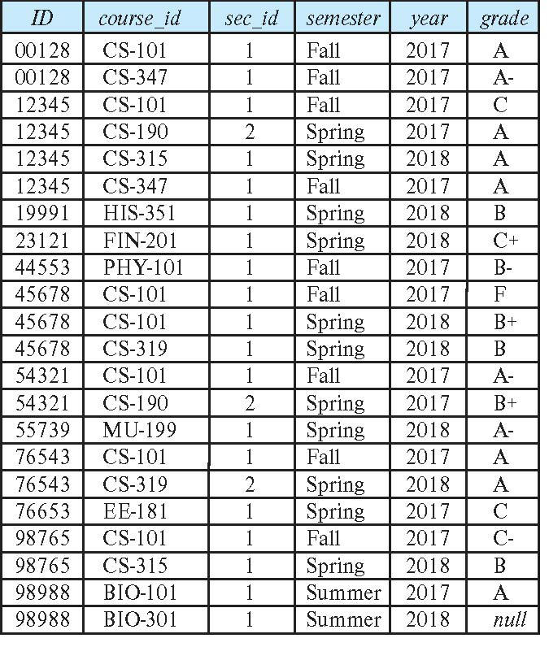
Takes Relation

Slide 130
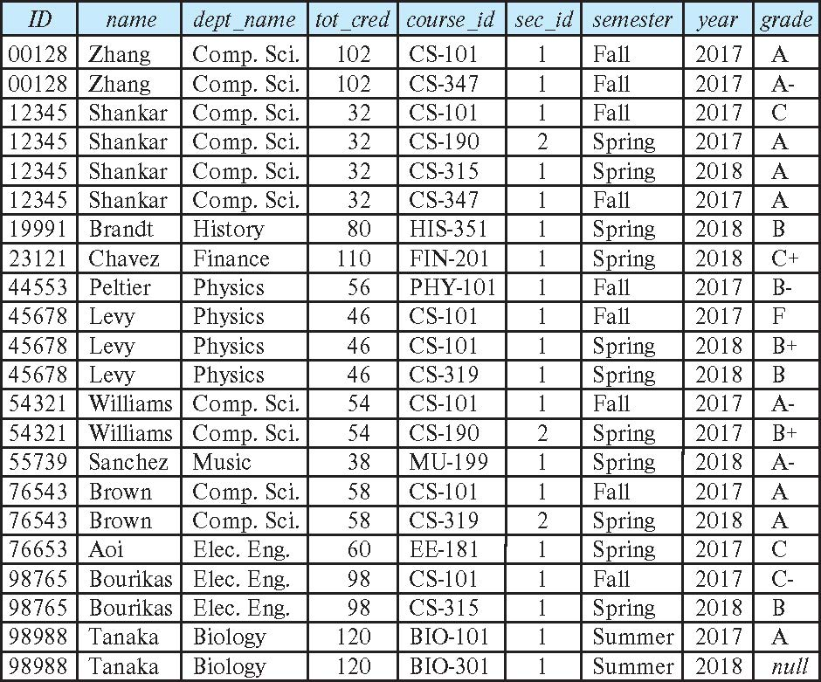
student natural join takes

Slide 131
Dangerous in Natural Join
Beware of unrelated attributes with same name which get equated incorrectly
Example -- List the names of students instructors along with the titles of courses that they have taken
Correct version
select name, title from student natural join takes, course where takes.course_id = course.course_id;
Incorrect version
select name, title from student natural join takes natural join course;
This query omits all (student name, course title) pairs where the student takes a course in a department other than the student's own department.
The correct version (above), correctly outputs such pairs.

Slide 132
Natural Join with Using Clause
To avoid the danger of equating attributes erroneously, we can use the “using” construct that allows us to specify exactly which columns should be equated.
Query example
select name, title from (student natural join takes) join course using (course_id)

Slide 133
Join Condition
The on condition allows a general predicate over the relations being joined
This predicate is written like a where clause predicate except for the use of the keyword on
Query example
select * from student join takes on student_ID = takes_ID
The on condition above specifies that a tuple from student matches a tuple from takes if their ID values are equal.
Equivalent to:
select * from student , takes where student_ID = takes_ID

Slide 134
Join Condition (Cont.)
The on condition allows a general predicate over the relations being joined.
This predicate is written like a where clause predicate except for the use of the keyword on.
Query example
select * from student join takes on student_ID = takes_ID
The on condition above specifies that a tuple from student matches a tuple from takes if their ID values are equal.
Equivalent to:
select * from student , takes where student_ID = takes_ID

Slide 135
Outer Join
An extension of the join operation that avoids loss of information.
Computes the join and then adds tuples form one relation that does not match tuples in the other relation to the result of the join.
Uses null values.
Three forms of outer join:
left outer join
right outer join
full outer join

Slide 136
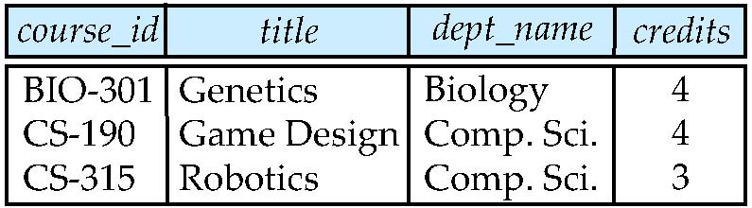
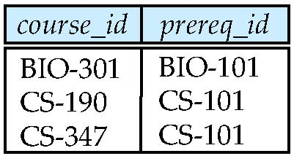
Outer Join Examples
Relation course
Relation prereq
Observe that
course information is missing CS-437
prereq information is missing CS-315
x

Slide 137
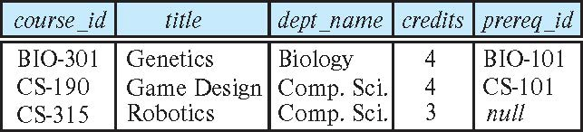
Left Outer Join
course natural left outer join prereq
In relational algebra: course ⟕ prereq

Slide 138
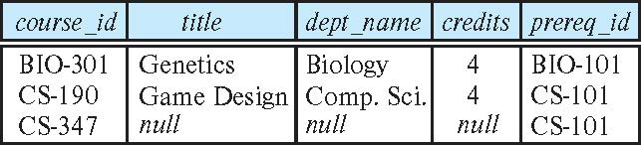
Right Outer Join
course natural right outer join prereq
In relational algebra: course ⟖ prereq

Slide 139
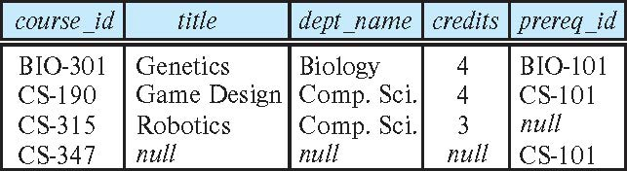
Full Outer Join
course natural full outer join prereq
In relational algebra: course ⟗ prereq

Slide 140
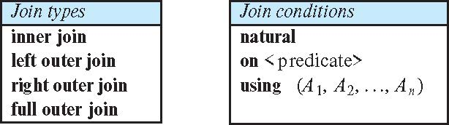
Joined Types and Conditions
Join operations take two relations and return as a result another relation.
These additional operations are typically used as subquery expressions in the from clause
Join condition – defines which tuples in the two relations match.
Join type – defines how tuples in each relation that do not match any tuple in the other relation (based on the join condition) are treated.

Slide 141
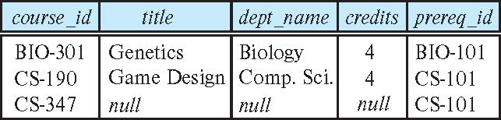
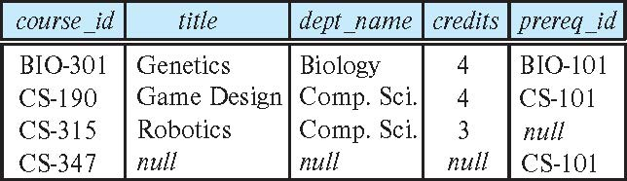
Joined Relations – Examples
course natural right outer join prereq
course full outer join prereq using (course_id)

Slide 142
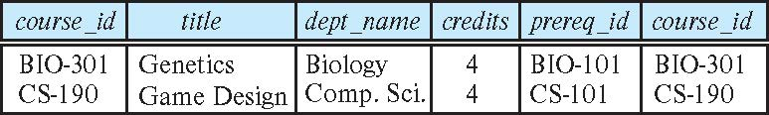
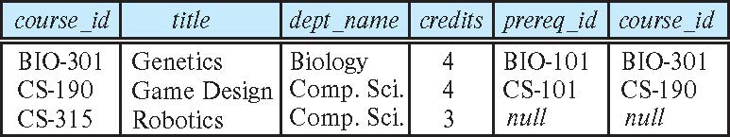
Joined Relations – Examples
course inner join prereq on course.course_id = prereq.course_id
What is the difference between the above, and a natural join?
course left outer join prereq on course.course_id = prereq.course_id

Slide 143
Joined Relations – Examples
course natural right outer join prereq
course full outer join prereq using (course_id)

Slide 144
Views
In some cases, it is not desirable for all users to see the entire logical model (that is, all the actual relations stored in the database.)
Consider a person who needs to know an instructors name and department, but not the salary. This person should see a relation described, in SQL, by select ID, name, dept_name from instructor
A view provides a mechanism to hide certain data from the view of certain users.
Any relation that is not of the conceptual model but is made visible to a user as a “virtual relation” is called a view.

Slide 145
View Definition
A view is defined using the create view statement which has the form
create view v as < query expression >
where <query expression> is any legal SQL expression. The view name is represented by v.
Once a view is defined, the view name can be used to refer to the virtual relation that the view generates.
View definition is not the same as creating a new relation by evaluating the query expression
Rather, a view definition causes the saving of an expression; the expression is substituted into queries using the view.

Slide 146
Example Views
A view of instructors without their salary create view faculty as select ID, name, dept_name from instructor
Find all instructors in the Biology department select name from faculty where dept_name = ‘Biology’
Create a view of department salary totals create view departments_total_salary(dept_name, total_salary) as select dept_name, sum (salary) from instructor group by dept_name;

Slide 147
Views Defined Using Other Views
create view physics_fall_2009 as select course.course_id, sec_id, building, room_number from course, section where course.course_id = section.course_id and course.dept_name = ’Physics’ and section.semester = ’Fall’ and section.year = ’2009’;
create view physics_fall_2009_watson as select course_id, room_number from physics_fall_2009 where building= ’Watson’;

Slide 148
View Expansion
Expand use of a view in a query/another view
create view physics_fall_2009_watson as
(select course_id, room_number
from (select course.course_id, building, room_number
from course, section
where course.course_id = section.course_id
and course.dept_name = ’Physics’
and section.semester = ’Fall’
and section.year = ’2009’)
where building= ’Watson’;

Slide 149
Views Defined Using Other Views
One view may be used in the expression defining another view
A view relation v₁ is said to depend directly on a view relation v₂ if v₂ is used in the expression defining v₁
A view relation v₁ is said to depend on view relation v₂ if either v₁ depends directly to v₂ or there is a path of dependencies from v₁ to v₂
A view relation v is said to be recursive if it depends on itself.

Slide 150
View Expansion
A way to define the meaning of views defined in terms of other views.
Let view v₁ be defined by an expression e₁ that may itself contain uses of view relations.
View expansion of an expression repeats the following replacement step:
repeat Find any view relation v_{i} in e₁ Replace the view relation v_{i} by the expression defining v_{i} until no more view relations are present in e₁
As long as the view definitions are not recursive, this loop will terminate

Slide 151
Update of a View
Add a new tuple to faculty view which we defined earlier
insert into faculty values (’30765’, ’Green’, ’Music’);
This insertion must be represented by the insertion of the tuple
(’30765’, ’Green’, ’Music’, null)
into the instructor relation

Slide 152
Some Updates cannot be Translated Uniquely
create view instructor_info as select ID, name, building from instructor, department where instructor.dept_name= department.dept_name;
insert into instructor_info values (’69987’, ’White’, ’Taylor’);
which department, if multiple departments in Taylor?
what if no department is in Taylor?
Most SQL implementations allow updates only on simple views
The from clause has only one database relation.
The select clause contains only attribute names of the relation, and does not have any expressions, aggregates, or distinct specification.
Any attribute not listed in the select clause can be set to null
The query does not have a group by or having clause.

Slide 153
And Some Not at All
create view history_instructors as select * from instructor where dept_name= ’History’;
What happens if we insert (’25566’, ’Brown’, ’Biology’, 100000) into history_instructors?

Slide 154
Materialized Views
Materializing a view: create a physical table containing all the tuples in the result of the query defining the view
If relations used in the query are updated, the materialized view result becomes out of date
Need to maintain the view, by updating the view whenever the underlying relations are updated.

Slide 155
Transactions
Unit of work
Atomic transaction
either fully executed or rolled back as if it never occurred
Isolation from concurrent transactions
Transactions begin implicitly
Ended by commit work or rollback work
But default on most databases: each SQL statement commits automatically
Can turn off auto commit for a session (e.g. using API)
In SQL:1999, can use: begin atomic …. end
Not supported on most databases

Slide 156
Integrity Constraints
Integrity constraints guard against accidental damage to the database, by ensuring that authorized changes to the database do not result in a loss of data consistency.
A checking account must have a balance greater than $10,000.00
A salary of a bank employee must be at least $4.00 an hour
A customer must have a (non-null) phone number

Slide 157
Integrity Constraints on a Single Relation
not null
primary key
unique
check (P), where P is a predicate

Slide 158
Not Null and Unique Constraints
not null
Declare name and budget to be not null
name varchar(20) not null budget numeric(12,2) not null
unique ( A₁, A₂, …, A_{m})
The unique specification states that the attributes A1, A2, … Am form a candidate key.
Candidate keys are permitted to be null (in contrast to primary keys).

Slide 159
The check clause
check (P)
where P is a predicate
Example: ensure that semester is one of fall, winter, spring or summer:
create table section (
course_id varchar (8),
sec_id varchar (8),
semester varchar (6),
year numeric (4,0),
building varchar (15),
room_number varchar (7),
time slot id varchar (4),
primary key (course_id, sec_id, semester, year),
check (semester in (’Fall’, ’Winter’, ’Spring’, ’Summer’)) );

Slide 160
Referential Integrity
Ensures that a value that appears in one relation for a given set of attributes also appears for a certain set of attributes in another relation.
Example: If “Biology” is a department name appearing in one of the tuples in the instructor relation, then there exists a tuple in the department relation for “Biology”.
Let A be a set of attributes. Let R and S be two relations that contain attributes A and where A is the primary key of S. A is said to be a foreign key of R if for any values of A appearing in R these values also appear in S.

Slide 161
Cascading Actions in Referential Integrity
create table course ( course_id char(5) primary key, title varchar(20), dept_name varchar(20) references department )
create table course ( … dept_name varchar(20), foreign key (dept_name) references department on delete cascade on update cascade, . . . )
alternative actions to cascade: set null, set default

Slide 162
Integrity Constraint Violation During Transactions
E.g.
create table person ( ID char(10), name char(40), mother char(10), father char(10), primary key ID, foreign key father references person, foreign key mother references person)
How to insert a tuple without causing constraint violation ?
insert father and mother of a person before inserting person
OR, set father and mother to null initially, update after inserting all persons (not possible if father and mother attributes declared to be not null)
OR defer constraint checking (next slide)

Slide 163
Complex Check Clauses
check (time_slot_id in (select time_slot_id from time_slot))
why not use a foreign key here?
Every section has at least one instructor teaching the section.
how to write this?
Unfortunately: subquery in check clause not supported by pretty much any database
Alternative: triggers (later)
create assertion <assertion-name> check <predicate>;
Also not supported by anyone

Slide 164
Built-in Data Types in SQL
date: Dates, containing a (4 digit) year, month and date
Example: date ‘2005-7-27’
time: Time of day, in hours, minutes and seconds.
Example: time ‘09:00:30’ time ‘09:00:30.75’
timestamp: date plus time of day
Example: timestamp ‘2005-7-27 09:00:30.75’
interval: period of time
Example: interval ‘1’ day
Subtracting a date/time/timestamp value from another gives an interval value
Interval values can be added to date/time/timestamp values

Slide 165
Index Creation
create table student (ID varchar (5), name varchar (20) not null, dept_name varchar (20), tot_cred numeric (3,0) default 0, primary key (ID))
create index studentID_index on student(ID)
Indices are data structures used to speed up access to records with specified values for index attributes
e.g. select * from student where ID = ‘12345’
can be executed by using the index to find the required record, without looking at all records of student
More on indices in Chapter 11

Slide 166
User-Defined Types
create type construct in SQL creates user-defined type
create type Dollars as numeric (12,2) final
create table department (dept_name varchar (20), building varchar (15), budget Dollars);

Slide 167
Domains
create domain construct in SQL-92 creates user-defined domain types
create domain person_name char(20) not null
Types and domains are similar. Domains can have constraints, such as not null, specified on them.
create domain degree_level varchar(10) constraint degree_level_test check (value in (’Bachelors’, ’Masters’, ’Doctorate’));

Slide 168
Large-Object Types
Large objects (photos, videos, CAD files, etc.) are stored as a large object:
blob: binary large object -- object is a large collection of uninterpreted binary data (whose interpretation is left to an application outside of the database system)
clob: character large object -- object is a large collection of character data
When a query returns a large object, a pointer is returned rather than the large object itself.

Slide 169
Authorization
Forms of authorization on parts of the database:
Read - allows reading, but not modification of data.
Insert - allows insertion of new data, but not modification of existing data.
Update - allows modification, but not deletion of data.
Delete - allows deletion of data.
Forms of authorization to modify the database schema
Index - allows creation and deletion of indices.
Resources - allows creation of new relations.
Alteration - allows addition or deletion of attributes in a relation.
Drop - allows deletion of relations.

Slide 170
Authorization Specification in SQL
The grant statement is used to confer authorization
grant <privilege list>
on <relation name or view name> to <user list>
<user list> is:
a user-id
public, which allows all valid users the privilege granted
A role (more on this later)
Granting a privilege on a view does not imply granting any privileges on the underlying relations.
The grantor of the privilege must already hold the privilege on the specified item (or be the database administrator).

Slide 171
Privileges in SQL
select: allows read access to relation,or the ability to query using the view
Example: grant users U₁, U₂, and U₃ select authorization on the instructor relation:
grant select on instructor to U₁, U₂, U₃
insert: the ability to insert tuples
update: the ability to update using the SQL update statement
delete: the ability to delete tuples.
all privileges: used as a short form for all the allowable privileges

Slide 172
Revoking Authorization in SQL
The revoke statement is used to revoke authorization.
revoke <privilege list>
on <relation name or view name> from <user list>
Example:
revoke select on branch from U₁, U₂, U₃
<privilege-list> may be all to revoke all privileges the revokee may hold.
If <revokee-list> includes public, all users lose the privilege except those granted it explicitly.
If the same privilege was granted twice to the same user by different grantees, the user may retain the privilege after the revocation.
All privileges that depend on the privilege being revoked are also revoked.

Slide 173
Roles
create role instructor;
grant instructor to Amit;
Privileges can be granted to roles:
grant select on takes to instructor;
Roles can be granted to users, as well as to other roles
create role teaching_assistant
grant teaching_assistant to instructor;
Instructor inherits all privileges of teaching_assistant
Chain of roles
create role dean;
grant instructor to dean;
grant dean to Satoshi;

Slide 174
Authorization on Views
create view geo_instructor as (select * from instructor where dept_name = ’Geology’);
grant select on geo_instructor to geo_staff
Suppose that a geo_staff member issues
select * from geo_instructor;
What if
geo_staff does not have permissions on instructor?
creator of view did not have some permissions on instructor?

Slide 175
Other Authorization Features
references privilege to create foreign key
grant reference (dept_name) on department to Mariano;
why is this required?
transfer of privileges
grant select on department to Amit with grant option;
revoke select on department from Amit, Satoshi cascade;
revoke select on department from Amit, Satoshi restrict;
Etc. read Section 4.6 for more details we have omitted here.

Slide 176
End of Chapter 4

Slide 177
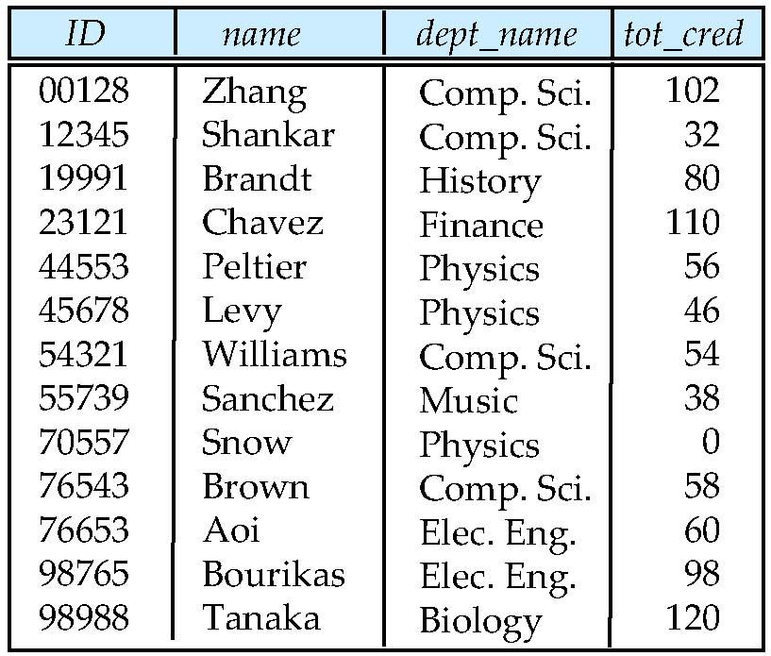
Figure 4.01

Slide 178
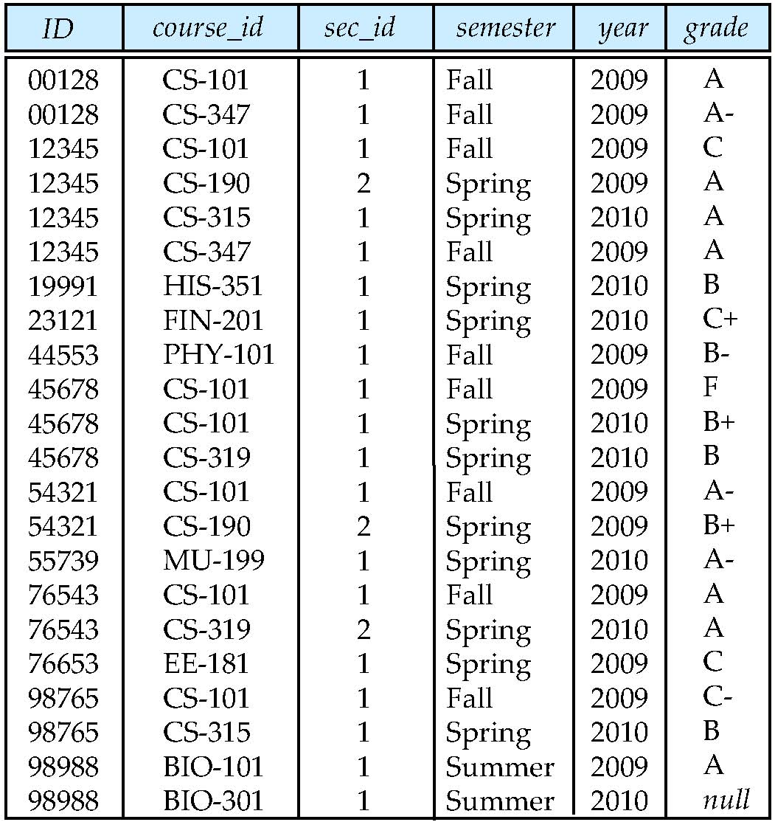
Figure 4.02

Slide 179
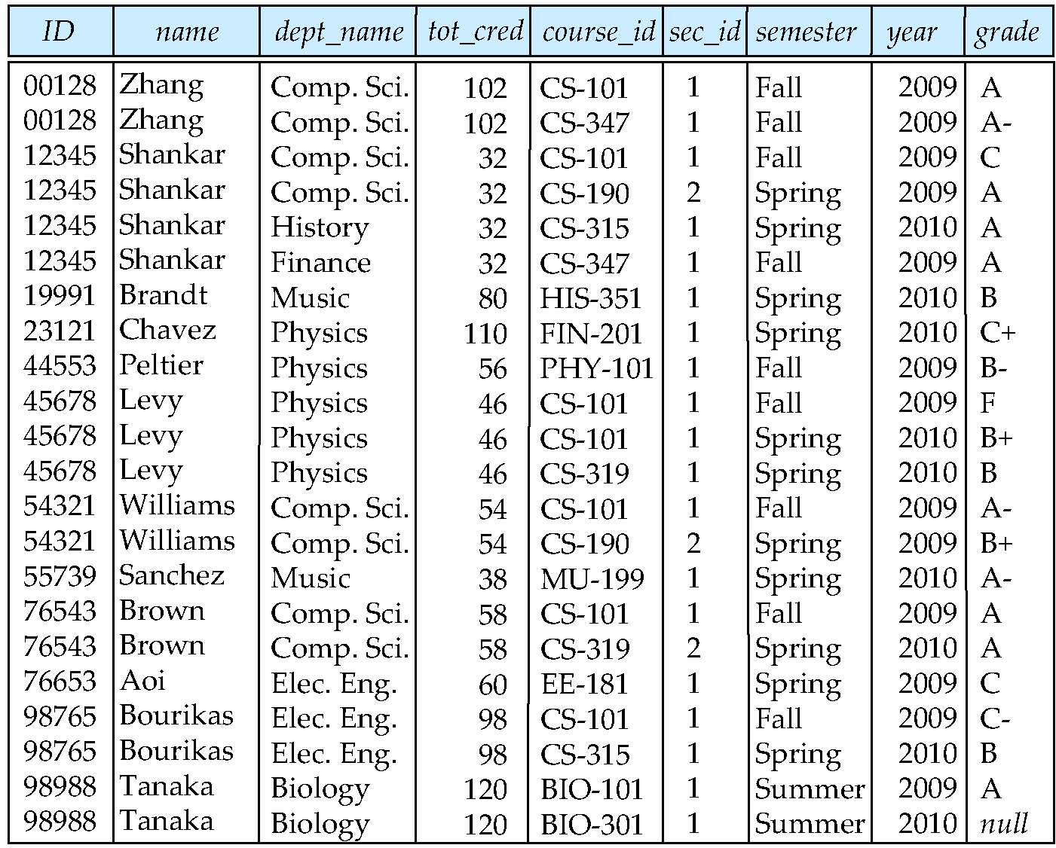
Figure 4.03

Slide 180
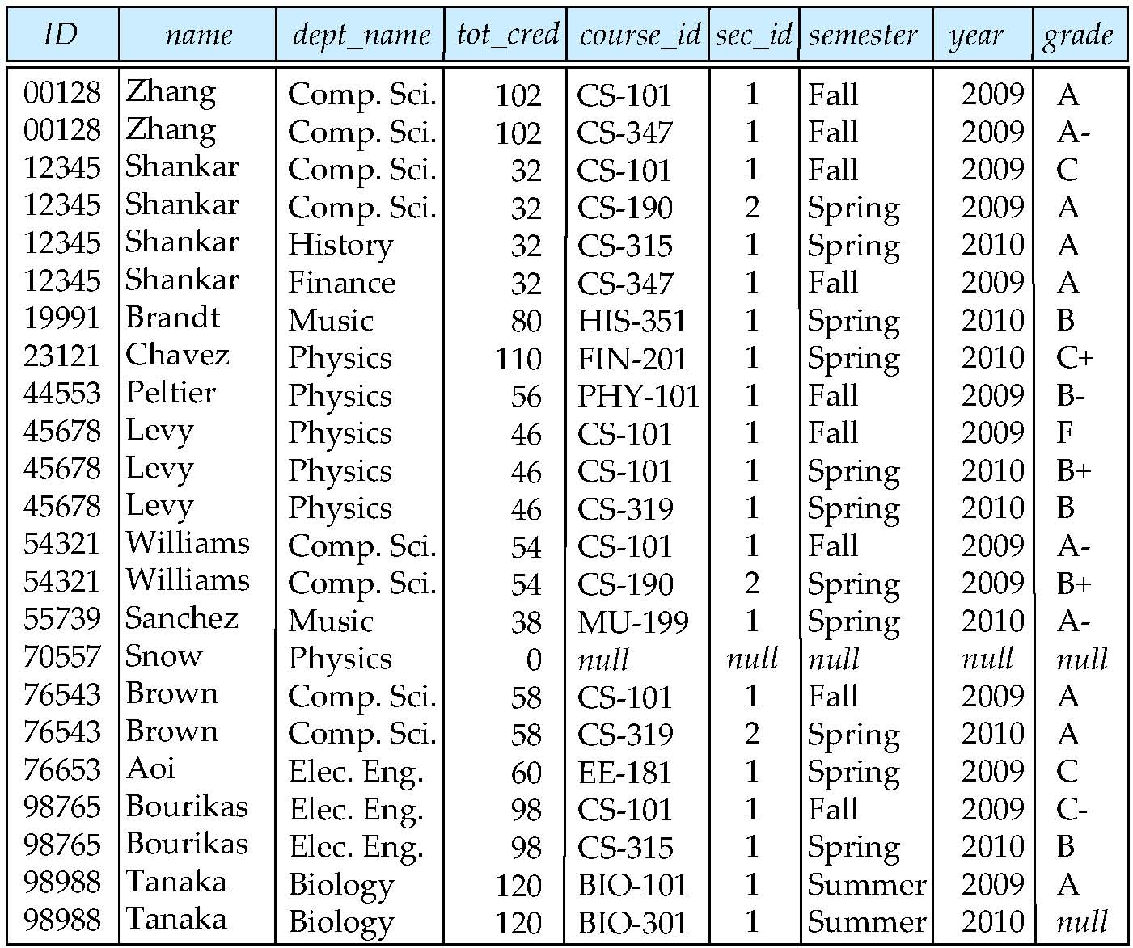
Figure 4.04

Slide 181
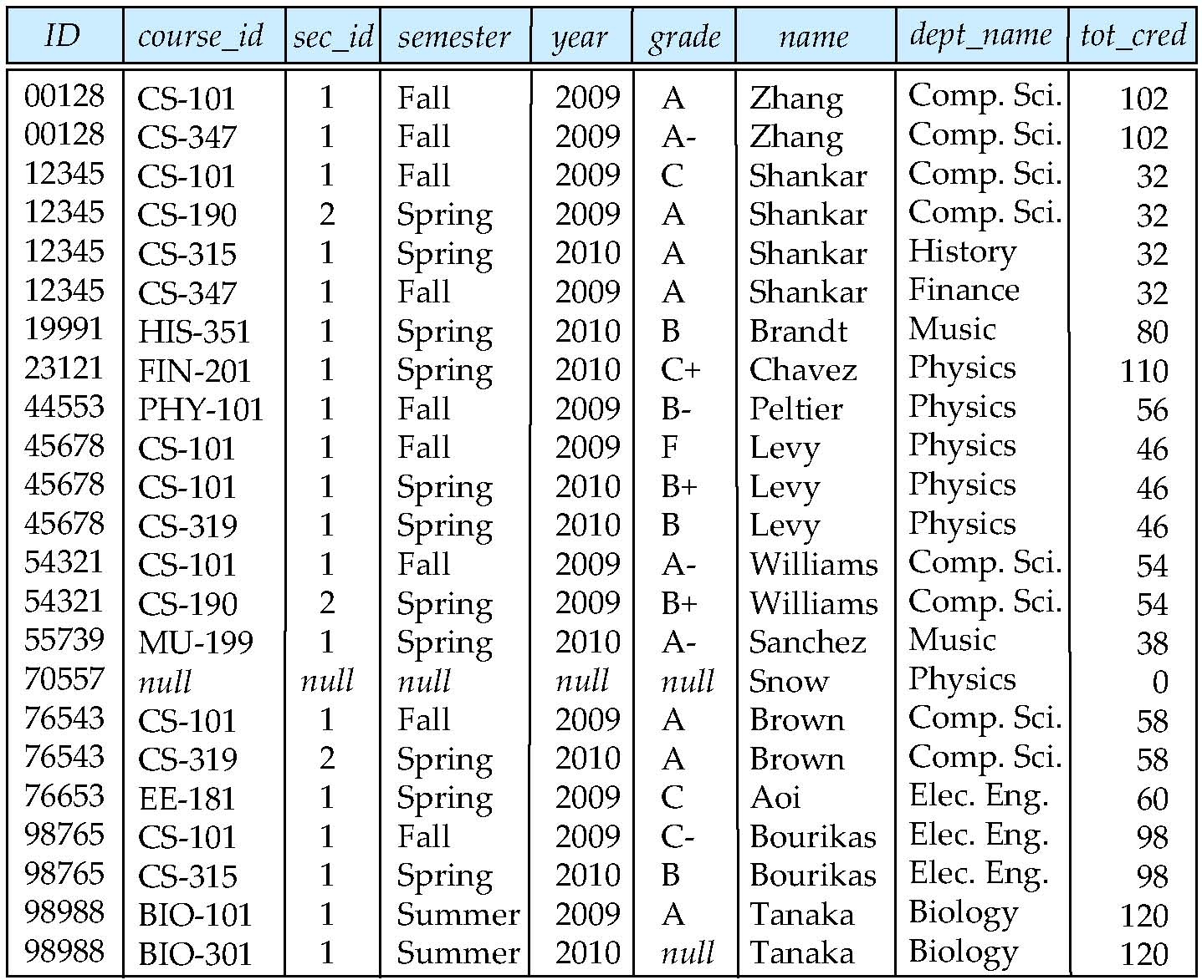
Figure 4.05

Slide 182
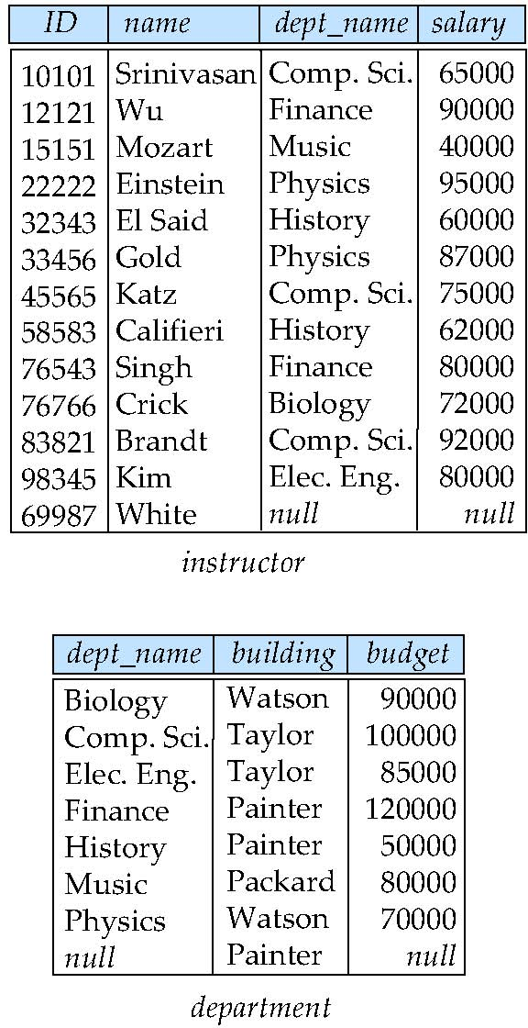
Figure 4.07
Taylor

Slide 183
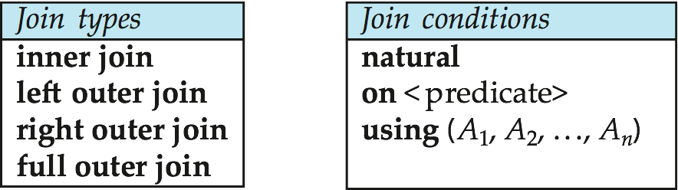
Figure 4.06

Slide 184
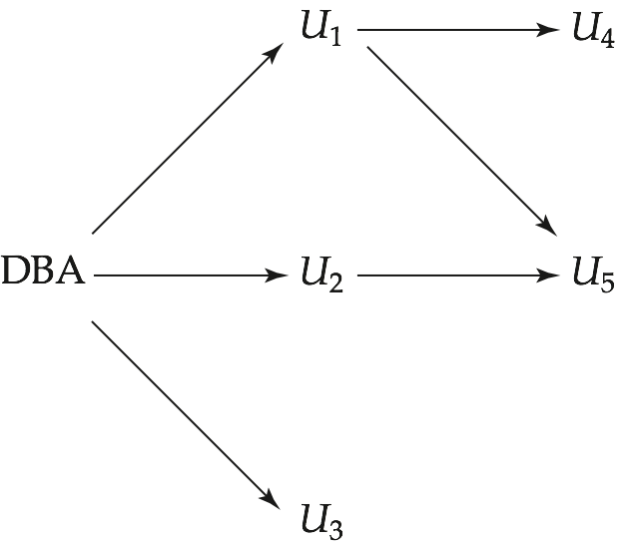
Figure 4.03

Slide 185
End of Chapter 4

Slide 186
Chapter 5: Advanced SQL

Slide 187
Outline
Accessing SQL From a Programming Language
Functions and Procedural Constructs
Triggers
Recursive Queries
Advanced Aggregation Features
OLAP

Slide 188
Accessing SQL From a Programming Language

Slide 189
Accessing SQL From a Programming Language
API (application-program interface) for a program to interact with a database server
Application makes calls to
Connect with the database server
Send SQL commands to the database server
Fetch tuples of result one-by-one into program variables
Various tools:
ODBC (Open Database Connectivity) works with C, C++, C#, and Visual Basic. Other API’s such as ADO.NET sit on top of ODBC
JDBC (Java Database Connectivity) works with Java
Embedded SQL

Slide 190
ODBC
Open DataBase Connectivity (ODBC) standard
standard for application program to communicate with a database server.
application program interface (API) to
open a connection with a database,
send queries and updates,
get back results.
Applications such as GUI, spreadsheets, etc. can use ODBC

Slide 191
JDBC
JDBC is a Java API for communicating with database systems supporting SQL.
JDBC supports a variety of features for querying and updating data, and for retrieving query results.
JDBC also supports metadata retrieval, such as querying about relations present in the database and the names and types of relation attributes.
Model for communicating with the database:
Open a connection
Create a “statement” object
Execute queries using the Statement object to send queries and fetch results
Exception mechanism to handle errors

Slide 192
JDBC Code
public static void JDBCexample(String dbid, String userid, String passwd)
{
try (Connection conn = DriverManager.getConnection( "jdbc:oracle:thin:@db.yale.edu:2000:univdb", userid, passwd);
Statement stmt = conn.createStatement(); )
{
… Do Actual Work ….
}
catch (SQLException sqle) {
System.out.println("SQLException : " + sqle);
}
}
NOTE: Above syntax works with Java 7, and JDBC 4 onwards. Resources opened in “try (….)” syntax (“try with resources”) are automatically closed at the end of the try block

Slide 193
JDBC Code for Older Versions of Java/JDBC
public static void JDBCexample(String dbid, String userid, String passwd)
{
try {
Class.forName ("oracle.jdbc.driver.OracleDriver");
Connection conn = DriverManager.getConnection( "jdbc:oracle:thin:@db.yale.edu:2000:univdb", userid, passwd);
Statement stmt = conn.createStatement();
… Do Actual Work ….
stmt.close();
conn.close();
}
catch (SQLException sqle) {
System.out.println("SQLException : " + sqle);
}
} NOTE: Classs.forName is not required from JDBC 4 onwards. The try with resources syntax in prev slide is preferred for Java 7 onwards.

Slide 194
JDBC Code (Cont.)
Update to database try { stmt.executeUpdate( "insert into instructor values(’77987’, ’Kim’, ’Physics’, 98000)"); } catch (SQLException sqle) { System.out.println("Could not insert tuple. " + sqle); }
Execute query and fetch and print results
ResultSet rset = stmt.executeQuery( "select dept_name, avg (salary) from instructor group by dept_name"); while (rset.next()) { System.out.println(rset.getString("dept_name") + " " + rset.getFloat(2)); }

Slide 195
JDBC Code Details
Getting result fields:
rs.getString(“dept_name”) and rs.getString(1) equivalent if dept_name is the first argument of select result.
Dealing with Null values
int a = rs.getInt(“a”);
if (rs.wasNull()) Systems.out.println(“Got null value”);

Slide 196
Prepared Statement
PreparedStatement pStmt = conn.prepareStatement( "insert into instructor values(?,?,?,?)"); pStmt.setString(1, "88877"); pStmt.setString(2, "Perry"); pStmt.setString(3, "Finance"); pStmt.setInt(4, 125000); pStmt.executeUpdate(); pStmt.setString(1, "88878"); pStmt.executeUpdate();
WARNING: always use prepared statements when taking an input from the user and adding it to a query
NEVER create a query by concatenating strings
"insert into instructor values(’ " + ID + " ’, ’ " + name + " ’, " + " ’ + dept name + " ’, " ’ balance + ")“
What if name is “D’Souza”?

Slide 197
SQL Injection
Suppose query is constructed using
"select * from instructor where name = ’" + name + "’"
Suppose the user, instead of entering a name, enters:
X’ or ’Y’ = ’Y
then the resulting statement becomes:
"select * from instructor where name = ’" + "X’ or ’Y’ = ’Y" + "’"
which is:
select * from instructor where name = ’X’ or ’Y’ = ’Y’
User could have even used
X’; update instructor set salary = salary + 10000; --
Prepared stament internally uses: "select * from instructor where name = ’X\’ or \’Y\’ = \’Y’
Always use prepared statements, with user inputs as parameters

Slide 198
Metadata Features
ResultSet metadata
E.g.after executing query to get a ResultSet rs:
ResultSetMetaData rsmd = rs.getMetaData();
for(int i = 1; i <= rsmd.getColumnCount(); i++) {
System.out.println(rsmd.getColumnName(i));
System.out.println(rsmd.getColumnTypeName(i));
}
How is this useful?

Slide 199
Metadata (Cont)
Database metadata
DatabaseMetaData dbmd = conn.getMetaData();
// Arguments to getColumns: Catalog, Schema-pattern, Table-pattern, // and Column-Pattern // Returns: One row for each column; row has a number of attributes // such as COLUMN_NAME, TYPE_NAME // The value null indicates all Catalogs/Schemas. // The value “” indicates current catalog/schema // The value “%” has the same meaning as SQL like clause
ResultSet rs = dbmd.getColumns(null, "univdb", "department", "%");
while( rs.next()) {
System.out.println(rs.getString("COLUMN_NAME"),
rs.getString("TYPE_NAME");
}
And where is this useful?

Slide 200
Metadata (Cont)
Database metadata
DatabaseMetaData dbmd = conn.getMetaData();
// Arguments to getTables: Catalog, Schema-pattern, Table-pattern, // and Table-Type // Returns: One row for each table; row has a number of attributes // such as TABLE_NAME, TABLE_CAT, TABLE_TYPE, .. // The value null indicates all Catalogs/Schemas. // The value “” indicates current catalog/schema // The value “%” has the same meaning as SQL like clause // The last attribute is an array of types of tables to return. // TABLE means only regular tables
ResultSet rs = dbmd.getTables (“”, "", “%", new String[] {“TABLES”});
while( rs.next()) {
System.out.println(rs.getString(“TABLE_NAME“));
}
And where is this useful?

Slide 201
Finding Primary Keys
DatabaseMetaData dmd = connection.getMetaData(); // Arguments below are: Catalog, Schema, and Table // The value “” for Catalog/Schema indicates current catalog/schema // The value null indicates all catalogs/schemas ResultSet rs = dmd.getPrimaryKeys(“”, “”, tableName); while(rs.next()){ // KEY_SEQ indicates the position of the attribute in // the primary key, which is required if a primary key has multiple // attributes System.out.println(rs.getString(“KEY_SEQ”), rs.getString("COLUMN_NAME"); }

Slide 202
Transaction Control in JDBC
By default, each SQL statement is treated as a separate transaction that is committed automatically
bad idea for transactions with multiple updates
Can turn off automatic commit on a connection
conn.setAutoCommit(false);
Transactions must then be committed or rolled back explicitly
conn.commit(); or
conn.rollback();
conn.setAutoCommit(true) turns on automatic commit.

Slide 203
Other JDBC Features
Calling functions and procedures
CallableStatement cStmt1 = conn.prepareCall("{? = call some function(?)}");
CallableStatement cStmt2 = conn.prepareCall("{call some procedure(?,?)}");
Handling large object types
getBlob() and getClob() that are similar to the getString() method, but return objects of type Blob and Clob, respectively
get data from these objects by getBytes()
associate an open stream with Java Blob or Clob object to update large objects
blob.setBlob(int parameterIndex, InputStream inputStream).

Slide 204
JDBC Resources
JDBC Basics Tutorial
https://docs.oracle.com/javase/tutorial/jdbc/index.html

Slide 205
SQLJ
JDBC is overly dynamic, errors cannot be caught by compiler
SQLJ: embedded SQL in Java
#sql iterator deptInfoIter ( String dept name, int avgSal);
deptInfoIter iter = null;
#sql iter = { select dept_name, avg(salary) from instructor
group by dept name };
while (iter.next()) {
String deptName = iter.dept_name();
int avgSal = iter.avgSal();
System.out.println(deptName + " " + avgSal);
}
iter.close();

Slide 206
Embedded SQL
The SQL standard defines embeddings of SQL in a variety of programming languages such as C, C++, Java, Fortran, and PL/1,
A language to which SQL queries are embedded is referred to as a host language, and the SQL structures permitted in the host language comprise embedded SQL.
The basic form of these languages follows that of the System R embedding of SQL into PL/1.
EXEC SQL statement is used to identify embedded SQL request to the preprocessor
EXEC SQL <embedded SQL statement >;
Note: this varies by language:
In some languages, like COBOL, the semicolon is replaced with END-EXEC
In Java embedding uses # SQL { …. };

Slide 207
Embedded SQL (Cont.)
Before executing any SQL statements, the program must first connect to the database. This is done using:
EXEC-SQL connect to server user user-name using password;
Here, server identifies the server to which a connection is to be established.
Variables of the host language can be used within embedded SQL statements. They are preceded by a colon (:) to distinguish from SQL variables (e.g., :credit_amount )
Variables used as above must be declared within DECLARE section, as illustrated below. The syntax for declaring the variables, however, follows the usual host language syntax.
EXEC-SQL BEGIN DECLARE SECTION}
int credit-amount ;
EXEC-SQL END DECLARE SECTION;

Slide 208
Embedded SQL (Cont.)
To write an embedded SQL query, we use the
declare c cursor for <SQL query>
statement. The variable c is used to identify the query
Example:
From within a host language, find the ID and name of students who have completed more than the number of credits stored in variable credit_amount in the host langue
Specify the query in SQL as follows:
EXEC SQL
declare c cursor for select ID, name from student where tot_cred > :credit_amount
END_EXEC

Slide 209
Embedded SQL (Cont.)
Example:
From within a host language, find the ID and name of students who have completed more than the number of credits stored in variable credit_amount in the host langue
Specify the query in SQL as follows:
EXEC SQL
declare c cursor for select ID, name from student where tot_cred > :credit_amount
END_EXEC
The variable c (used in the cursor declaration) is used to identify the query

Slide 210
Embedded SQL (Cont.)
The open statement for our example is as follows:
EXEC SQL open c ;
This statement causes the database system to execute the query and to save the results within a temporary relation. The query uses the value of the host-language variable credit-amount at the time the open statement is executed.
The fetch statement causes the values of one tuple in the query result to be placed on host language variables.
EXEC SQL fetch c into :si, :sn END_EXEC
Repeated calls to fetch get successive tuples in the query result

Slide 211
Embedded SQL (Cont.)
A variable called SQLSTATE in the SQL communication area (SQLCA) gets set to ‘02000’ to indicate no more data is available
The close statement causes the database system to delete the temporary relation that holds the result of the query.
EXEC SQL close c ;
Note: above details vary with language. For example, the Java embedding defines Java iterators to step through result tuples.

Slide 212
Updates Through Embedded SQL
Embedded SQL expressions for database modification (update, insert, and delete)
Can update tuples fetched by cursor by declaring that the cursor is for update
EXEC SQL
declare c cursor for select * from instructor where dept_name = ‘Music’ for update
We then iterate through the tuples by performing fetch operations on the cursor (as illustrated earlier), and after fetching each tuple we execute the following code:
update instructor set salary = salary + 1000 where current of c

Slide 213
Extensions to SQL

Slide 214
Functions and Procedures
SQL:1999 supports functions and procedures
Functions/procedures can be written in SQL itself, or in an external programming language (e.g., C, Java).
Functions written in an external languages are particularly useful with specialized data types such as images and geometric objects.
Example: functions to check if polygons overlap, or to compare images for similarity.
Some database systems support table-valued functions, which can return a relation as a result.
SQL:1999 also supports a rich set of imperative constructs, including
Loops, if-then-else, assignment
Many databases have proprietary procedural extensions to SQL that differ from SQL:1999.

Slide 215
SQL Functions
Define a function that, given the name of a department, returns the count of the number of instructors in that department.
create function dept_count (dept_name varchar(20)) returns integer begin declare d_count integer; select count (* ) into d_count from instructor where instructor.dept_name = dept_name return d_count; end
The function dept_count can be used to find the department names and budget of all departments with more that 12 instructors.
select dept_name, budget from department where dept_count (dept_name ) > 12

Slide 216
SQL functions (Cont.)
Compound statement: begin … end
May contain multiple SQL statements between begin and end.
returns -- indicates the variable-type that is returned (e.g., integer)
return -- specifies the values that are to be returned as result of invoking the function
SQL function are in fact parameterized views that generalize the regular notion of views by allowing parameters.

Slide 217
Table Functions
SQL:2003 added functions that return a relation as a result
Example: Return all instructors in a given department
create function instructor_of (dept_name char(20))
returns table (
ID varchar(5), name varchar(20), dept_name varchar(20), salary numeric(8,2))
return table (select ID, name, dept_name, salary from instructor where instructor.dept_name = instructor_of.dept_name)
Usage
select * from table (instructor_of (‘Music’))

Slide 218
SQL Procedures
The dept_count function could instead be written as procedure:
create procedure dept_count_proc (in dept_name varchar(20), out d_count integer) begin
select count(*) into d_count from instructor where instructor.dept_name = dept_count_proc.dept_name
end
Procedures can be invoked either from an SQL procedure or from embedded SQL, using the call statement.
declare d_count integer; call dept_count_proc( ‘Physics’, d_count);
Procedures and functions can be invoked also from dynamic SQL
SQL:1999 allows more than one function/procedure of the same name (called name overloading), as long as the number of arguments differ, or at least the types of the arguments differ

Slide 219
Language Constructs for Procedures & Functions
SQL supports constructs that gives it almost all the power of a general-purpose programming language.
Warning: most database systems implement their own variant of the standard syntax below.
Compound statement: begin … end,
May contain multiple SQL statements between begin and end.
Local variables can be declared within a compound statements
While and repeat statements:
while boolean expression do
sequence of statements ;
end while
repeat
sequence of statements ;
until boolean expression
end repeat

Slide 220
Language Constructs (Cont.)
For loop
Permits iteration over all results of a query
Example: Find the budget of all departments declare n integer default 0; for r as select budget from department do set n = n + r.budget end for

Slide 221
Language Constructs (Cont.)
Conditional statements (if-then-else) SQL:1999 also supports a case statement similar to C case statement
Example procedure: registers student after ensuring classroom capacity is not exceeded
Returns 0 on success and -1 if capacity is exceeded
See book (page 177) for details
Signaling of exception conditions, and declaring handlers for exceptions
declare out_of_classroom_seats condition declare exit handler for out_of_classroom_seats begin … .. signal out_of_classroom_seats end
The handler here is exit -- causes enclosing begin..end to be exited
Other actions possible on exception

Slide 222
External Language Routines
SQL:1999 permits the use of functions and procedures written in other languages such as C or C++
Declaring external language procedures and functions
create procedure dept_count_proc(in dept_name varchar(20), out count integer) language C external name ’ /usr/avi/bin/dept_count_proc’ create function dept_count(dept_name varchar(20)) returns integer language C external name ‘/usr/avi/bin/dept_count’

Slide 223
External Language Routines
SQL:1999 allows the definition of procedures in an imperative programming language, (Java, C#, C or C++) which can be invoked from SQL queries.
Functions defined in this fashion can be more efficient than functions defined in SQL, and computations that cannot be carried out in SQL can be executed by these functions.
Declaring external language procedures and functions
create procedure dept_count_proc(in dept_name varchar(20), out count integer) language C external name ’ /usr/avi/bin/dept_count_proc’ create function dept_count(dept_name varchar(20)) returns integer language C external name ‘/usr/avi/bin/dept_count’

Slide 224
External Language Routines (Cont.)
Benefits of external language functions/procedures:
more efficient for many operations, and more expressive power.
Drawbacks
Code to implement function may need to be loaded into database system and executed in the database system’s address space.
risk of accidental corruption of database structures
security risk, allowing users access to unauthorized data
There are alternatives, which give good security at the cost of potentially worse performance.
Direct execution in the database system’s space is used when efficiency is more important than security.

Slide 225
Security with External Language Routines
To deal with security problems, we can do on of the following:
Use sandbox techniques
That is, use a safe language like Java, which cannot be used to access/damage other parts of the database code.
Run external language functions/procedures in a separate process, with no access to the database process’ memory.
Parameters and results communicated via inter-process communication
Both have performance overheads
Many database systems support both above approaches as well as direct executing in database system address space.

Slide 226
Triggers

Slide 227
Triggers
A trigger is a statement that is executed automatically by the system as a side effect of a modification to the database.
To design a trigger mechanism, we must:
Specify the conditions under which the trigger is to be executed.
Specify the actions to be taken when the trigger executes.
Triggers introduced to SQL standard in SQL:1999, but supported even earlier using non-standard syntax by most databases.
Syntax illustrated here may not work exactly on your database system; check the system manuals

Slide 228
Triggering Events and Actions in SQL
Triggering event can be insert, delete or update
Triggers on update can be restricted to specific attributes
For example, after update of takes on grade
Values of attributes before and after an update can be referenced
referencing old row as : for deletes and updates
referencing new row as : for inserts and updates
Triggers can be activated before an event, which can serve as extra constraints. For example, convert blank grades to null.
create trigger setnull_trigger before update of takes referencing new row as nrow for each row when (nrow.grade = ‘ ‘) begin atomic set nrow.grade = null; end;

Slide 229
Trigger to Maintain credits_earned value
create trigger credits_earned after update of takes on (grade) referencing new row as nrow referencing old row as orow for each row when nrow.grade <> ’F’ and nrow.grade is not null and (orow.grade = ’F’ or orow.grade is null) begin atomic update student set tot_cred= tot_cred + (select credits from course where course.course_id= nrow.course_id) where student.id = nrow.id; end;

Slide 230
Statement Level Triggers
Instead of executing a separate action for each affected row, a single action can be executed for all rows affected by a transaction
Use for each statement instead of for each row
Use referencing old table or referencing new table to refer to temporary tables (called transition tables) containing the affected rows
Can be more efficient when dealing with SQL statements that update a large number of rows

Slide 231
When Not To Use Triggers
Triggers were used earlier for tasks such as
Maintaining summary data (e.g., total salary of each department)
Replicating databases by recording changes to special relations (called change or delta relations) and having a separate process that applies the changes over to a replica
There are better ways of doing these now:
Databases today provide built in materialized view facilities to maintain summary data
Databases provide built-in support for replication
Encapsulation facilities can be used instead of triggers in many cases
Define methods to update fields
Carry out actions as part of the update methods instead of through a trigger

Slide 232
When Not To Use Triggers (Cont.)
Risk of unintended execution of triggers, for example, when
Loading data from a backup copy
Replicating updates at a remote site
Trigger execution can be disabled before such actions.
Other risks with triggers:
Error leading to failure of critical transactions that set off the trigger
Cascading execution

Slide 233
Recursive Queries

Slide 234
Recursion in SQL
SQL:1999 permits recursive view definition
Example: find which courses are a prerequisite, whether directly or indirectly, for a specific course with recursive rec_prereq(course_id, prereq_id) as ( select course_id, prereq_id from prereq union select rec_prereq.course_id, prereq.prereq_id, from rec_rereq, prereq where rec_prereq.prereq_id = prereq.course_id ) select ∗ from rec_prereq;
This example view, rec_prereq, is called the transitive closure of the prereq relation
Note: 1st printing of 6th ed erroneously used c_prereq in place of rec_prereq in some places

Slide 235
The Power of Recursion
Recursive views make it possible to write queries, such as transitive closure queries, that cannot be written without recursion or iteration.
Intuition: Without recursion, a non-recursive non-iterative program can perform only a fixed number of joins of prereq with itself
This can give only a fixed number of levels of managers
Given a fixed non-recursive query, we can construct a database with a greater number of levels of prerequisites on which the query will not work
Alternative: write a procedure to iterate as many times as required
See procedure findAllPrereqs in book

Slide 236
The Power of Recursion
Computing transitive closure using iteration, adding successive tuples to rec_prereq
The next slide shows a prereq relation
Each step of the iterative process constructs an extended version of rec_prereq from its recursive definition.
The final result is called the fixed point of the recursive view definition.
Recursive views are required to be monotonic. That is, if we add tuples to prereq the view rec_prereq contains all of the tuples it contained before, plus possibly more
Notes:
236

Slide 237
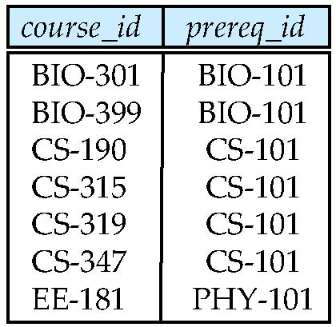
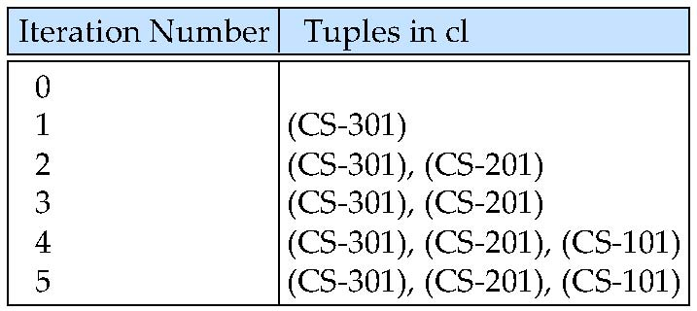
Example of Fixed-Point Computation

Slide 238
Advanced Aggregation Features

Slide 239
Ranking
Ranking is done in conjunction with an order by specification.
Suppose we are given a relation student_grades(ID, GPA) giving the grade-point average of each student
Find the rank of each student.
select ID, rank() over (order by GPA desc) as s_rank from student_grades
An extra order by clause is needed to get them in sorted order
select ID, rank() over (order by GPA desc) as s_rank from student_grades order by s_rank
Ranking may leave gaps: e.g. if 2 students have the same top GPA, both have rank 1, and the next rank is 3
dense_rank does not leave gaps, so next dense rank would be 2
Notes:
239

Slide 240
Ranking
Ranking can be done using basic SQL aggregation, but resultant query is very inefficient
select ID, (1 + (select count(*) from student_grades B where B.GPA > A.GPA)) as s_rank from student_grades A order by s_rank;

Slide 241
Ranking (Cont.)
Ranking can be done within partition of the data.
“Find the rank of students within each department.”
select ID, dept_name, rank () over (partition by dept_name order by GPA desc) as dept_rank from dept_grades order by dept_name, dept_rank;
Multiple rank clauses can occur in a single select clause.
Ranking is done after applying group by clause/aggregation
Can be used to find top-n results
More general than the limit n clause supported by many databases, since it allows top-n within each partition

Slide 242
Ranking (Cont.)
Other ranking functions:
percent_rank (within partition, if partitioning is done)
cume_dist (cumulative distribution)
fraction of tuples with preceding values
row_number (non-deterministic in presence of duplicates)
SQL:1999 permits the user to specify nulls first or nulls last
select ID, rank ( ) over (order by GPA desc nulls last) as s_rank from student_grades
Notes:
242

Slide 243
Ranking (Cont.)
For a given constant n, the ranking the function ntile(n) takes the tuples in each partition in the specified order, and divides them into n buckets with equal numbers of tuples.
E.g.,
select ID, ntile(4) over (order by GPA desc) as quartile from student_grades;
Notes:
243

Slide 244
Windowing
Used to smooth out random variations.
E.g., moving average: “Given sales values for each date, calculate for each date the average of the sales on that day, the previous day, and the next day”
Window specification in SQL:
Given relation sales(date, value)
select date, sum(value) over (order by date between rows 1 preceding and 1 following) from sales
Notes:
244

Slide 245
Windowing
Examples of other window specifications:
between rows unbounded preceding and current
rows unbounded preceding
range between 10 preceding and current row
All rows with values between current row value –10 to current value
range interval 10 day preceding
Not including current row
Notes:
245

Slide 246
Windowing (Cont.)
Can do windowing within partitions
E.g., Given a relation transaction (account_number, date_time, value), where value is positive for a deposit and negative for a withdrawal
“Find total balance of each account after each transaction on the account”
select account_number, date_time, sum (value) over (partition by account_number order by date_time rows unbounded preceding) as balance from transaction order by account_number, date_time
Notes:
246

Slide 247
OLAP

Slide 248
Data Analysis and OLAP
Online Analytical Processing (OLAP)
Interactive analysis of data, allowing data to be summarized and viewed in different ways in an online fashion (with negligible delay)
Data that can be modeled as dimension attributes and measure attributes are called multidimensional data.
Measure attributes
measure some value
can be aggregated upon
e.g., the attribute number of the sales relation
Dimension attributes
define the dimensions on which measure attributes (or aggregates thereof) are viewed
e.g., attributes item_name, color, and size of the sales relation

Slide 249
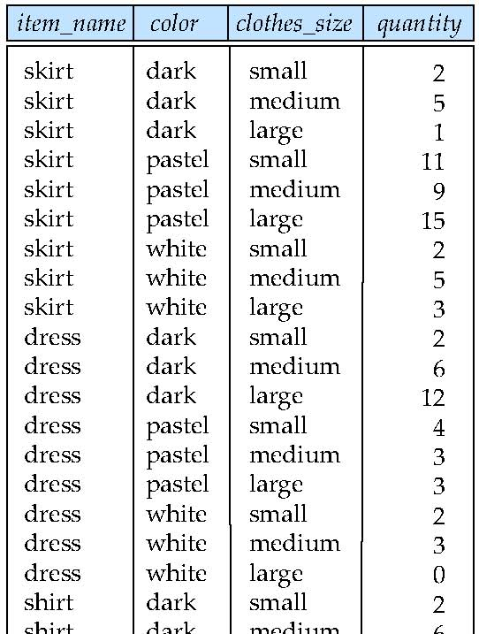
Example sales relation
...
...
...
...
...
...
...
...

Slide 250
Cross Tabulation of sales by item_name and color
The table above is an example of a cross-tabulation (cross-tab), also referred to as a pivot-table.
Values for one of the dimension attributes form the row headers
Values for another dimension attribute form the column headers
Other dimension attributes are listed on top
Values in individual cells are (aggregates of) the values of the dimension attributes that specify the cell.

Slide 251
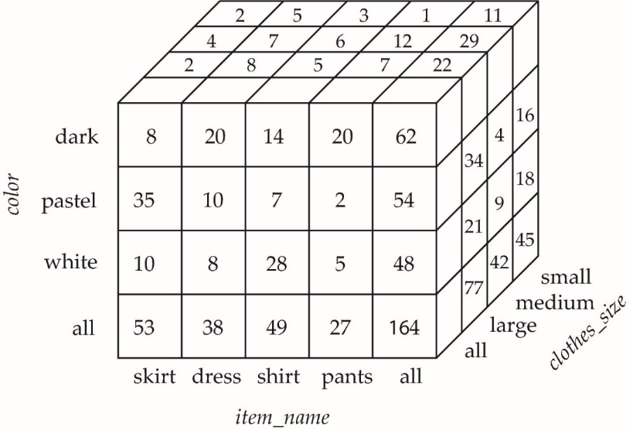
Data Cube
A data cube is a multidimensional generalization of a cross-tab
Can have n dimensions; we show 3 below
Cross-tabs can be used as views on a data cube

Slide 252
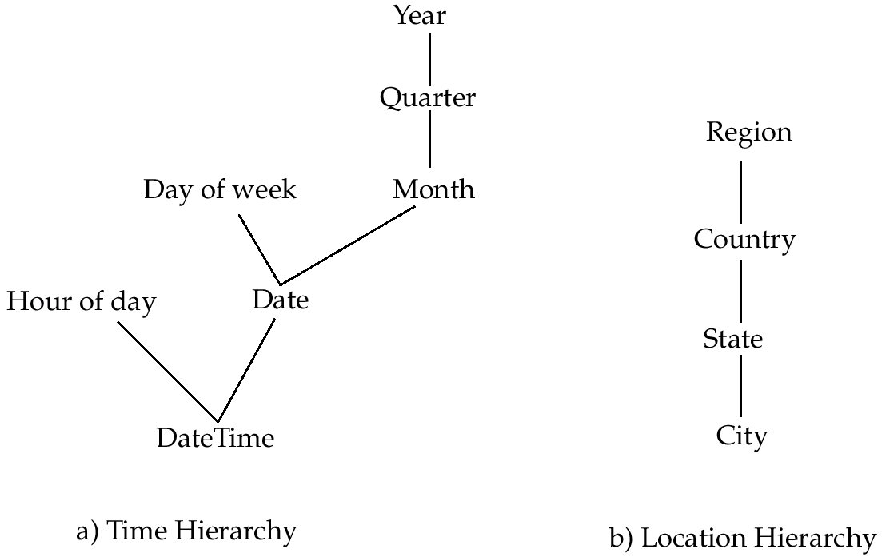
Hierarchies on Dimensions
Hierarchy on dimension attributes: lets dimensions to be viewed at different levels of detail
E.g., the dimension DateTime can be used to aggregate by hour of day, date, day of week, month, quarter or year

Slide 253
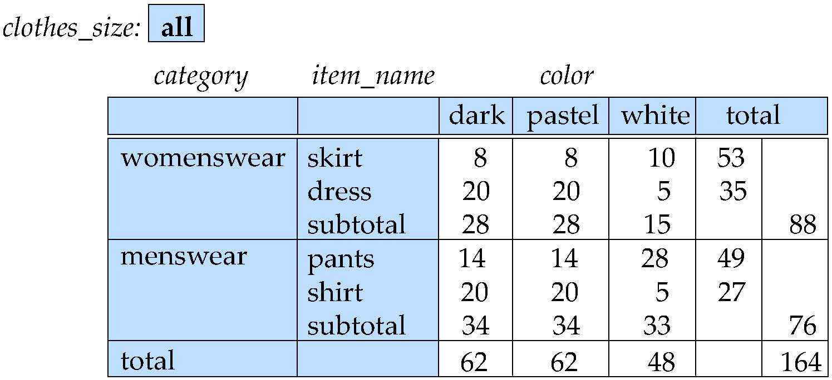
Cross Tabulation With Hierarchy
Cross-tabs can be easily extended to deal with hierarchies
Can drill down or roll up on a hierarchy

Slide 254
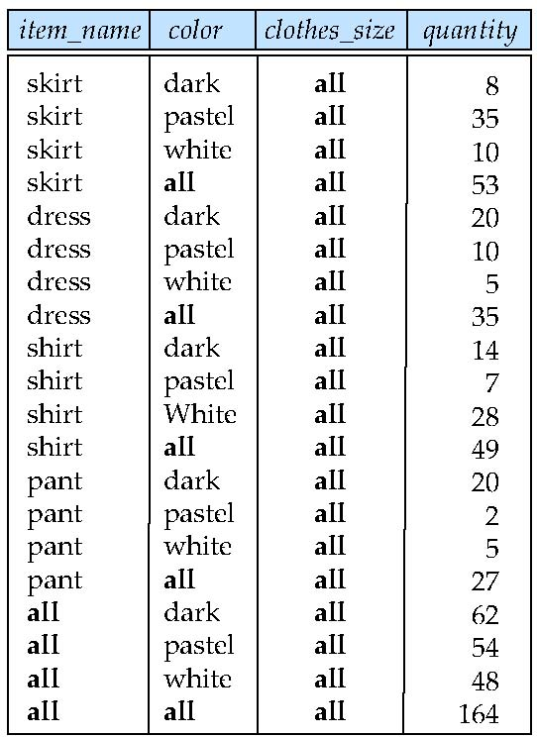
Relational Representation of Cross-tabs
Cross-tabs can be represented as relations
We use the value all is used to represent aggregates.
The SQL standard actually uses null values in place of all despite confusion with regular null values.

Slide 255
Extended Aggregation to Support OLAP
The cube operation computes union of group by’s on every subset of the specified attributes
Example relation for this section sales(item_name, color, clothes_size, quantity)
E.g. consider the query
select item_name, color, size, sum(number) from sales group by cube(item_name, color, size)
This computes the union of eight different groupings of the sales relation:
{ (item_name, color, size), (item_name, color), (item_name, size), (color, size), (item_name), (color), (size), ( ) }
where ( ) denotes an empty group by list.
For each grouping, the result contains the null value for attributes not present in the grouping.
Notes:
255

Slide 256
Online Analytical Processing Operations
Relational representation of cross-tab that we saw earlier, but with null in place of all, can be computed by
select item_name, color, sum(number) from sales group by cube(item_name, color)
The function grouping() can be applied on an attribute
Returns 1 if the value is a null value representing all, and returns 0 in all other cases.
select item_name, color, size, sum(number), grouping(item_name) as item_name_flag, grouping(color) as color_flag, grouping(size) as size_flag, from sales group by cube(item_name, color, size)
Notes:
256

Slide 257
Online Analytical Processing Operations
Can use the function decode() in the select clause to replace such nulls by a value such as all
E.g., replace item_name in first query by decode( grouping(item_name), 1, ‘all’, item_name)
Notes:
257

Slide 258
Extended Aggregation (Cont.)
The rollup construct generates union on every prefix of specified list of attributes
E.g.,
select item_name, color, size, sum(number) from sales group by rollup(item_name, color, size)
Generates union of four groupings:
{ (item_name, color, size), (item_name, color), (item_name), ( ) }
Rollup can be used to generate aggregates at multiple levels of a hierarchy.
E.g., suppose table itemcategory(item_name, category) gives the category of each item. Then
select category, item_name, sum(number) from sales, itemcategory where sales.item_name = itemcategory.item_name group by rollup(category, item_name)
would give a hierarchical summary by item_name and by category.
Notes:
258

Slide 259
Extended Aggregation (Cont.)
Multiple rollups and cubes can be used in a single group by clause
Each generates set of group by lists, cross product of sets gives overall set of group by lists
E.g.,
select item_name, color, size, sum(number) from sales group by rollup(item_name), rollup(color, size)
generates the groupings
{item_name, ()} X {(color, size), (color), ()}
= { (item_name, color, size), (item_name, color), (item_name), (color, size), (color), ( ) }
Notes:
259

Slide 260
Online Analytical Processing Operations
Pivoting: changing the dimensions used in a cross-tab is called
Slicing: creating a cross-tab for fixed values only
Sometimes called dicing, particularly when values for multiple dimensions are fixed.
Rollup: moving from finer-granularity data to a coarser granularity
Drill down: The opposite operation - that of moving from coarser-granularity data to finer-granularity data

Slide 261
OLAP Implementation
The earliest OLAP systems used multidimensional arrays in memory to store data cubes, and are referred to as multidimensional OLAP (MOLAP) systems.
OLAP implementations using only relational database features are called relational OLAP (ROLAP) systems
Hybrid systems, which store some summaries in memory and store the base data and other summaries in a relational database, are called hybrid OLAP (HOLAP) systems.

Slide 262
OLAP Implementation (Cont.)
Early OLAP systems precomputed all possible aggregates in order to provide online response
Space and time requirements for doing so can be very high
2^{n} combinations of group by
It suffices to precompute some aggregates, and compute others on demand from one of the precomputed aggregates
Can compute aggregate on (item_name, color) from an aggregate on (item_name, color, size)
For all but a few “non-decomposable” aggregates such as median
is cheaper than computing it from scratch
Several optimizations available for computing multiple aggregates
Can compute aggregate on (item_name, color) from an aggregate on (item_name, color, size)
Can compute aggregates on (item_name, color, size), (item_name, color) and (item_name) using a single sorting of the base data

Slide 263
End of Chapter 5

